Slide 1
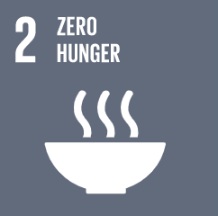

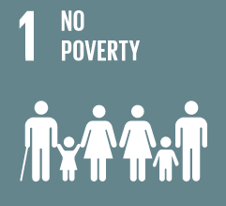
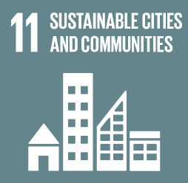
CONFLICT’S IMPACTS ON FOOD SYSTEMS:
EVIDENCE FROM HAITI
Dr Ronak Patel (Harvard Humanitarian Initiative) & Dr Caitriona Dowd (Dublin City University)
Dr Kelsey Gleason (University of Vermont)
Sam Polzin (University of Indiana)
Eric Calpas (Haiti); Hassan-Alattar Satti (Sudan); AbdiRashid hussein and Ibrahim Ambar (Somalia)
Denise Ripamonti and Angela Garvey (Dublin City University)

Slide 2
Research Question
HAITI
How does conflict and violence create and disrupt the rural to urban value chain for food as it exists and how do women throughout this chain navigate it?
\

Slide 3
DESIGN AND METHODS
Systems thinking to disentangle complex factors, relationships and impacts and identify leverage points for the greatest impact.
Five-part process:
Evidence review;
8 Key Informant Interviews (KIIs);
5 Focus Group Discussions (FGDs);
Fuzzy Cognitive Mapping (FCMs);
Survey triangulation (n=972).

Slide 4
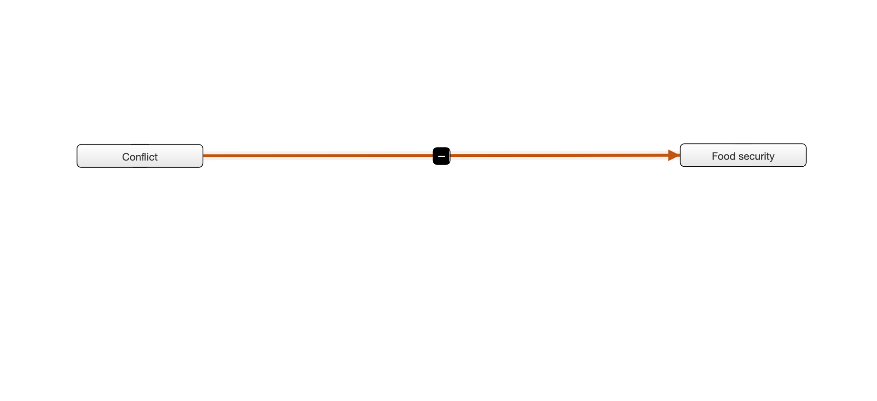
MAPPING EXAMPLE

Slide 5
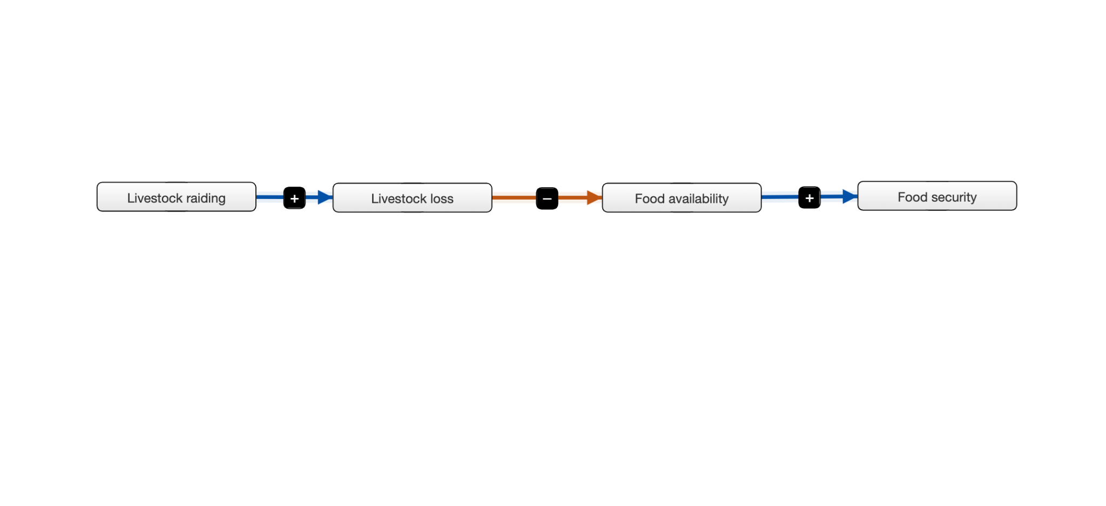
MAPPING EXAMPLE

Slide 6
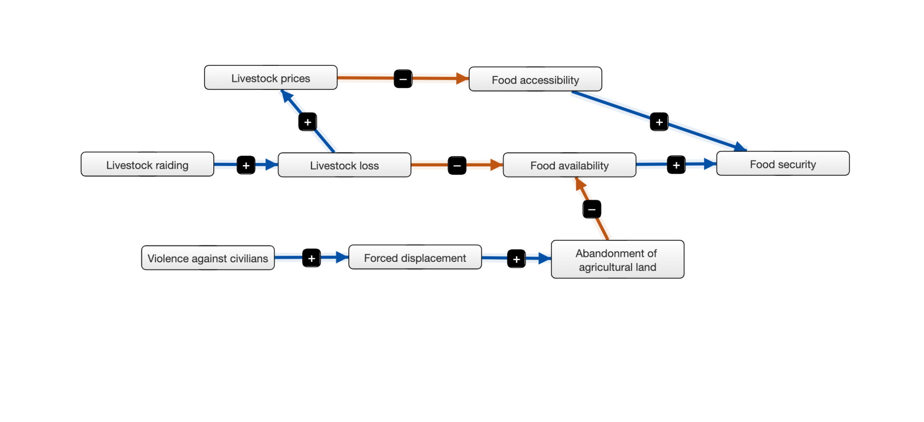
MAPPING EXAMPLE

Slide 7
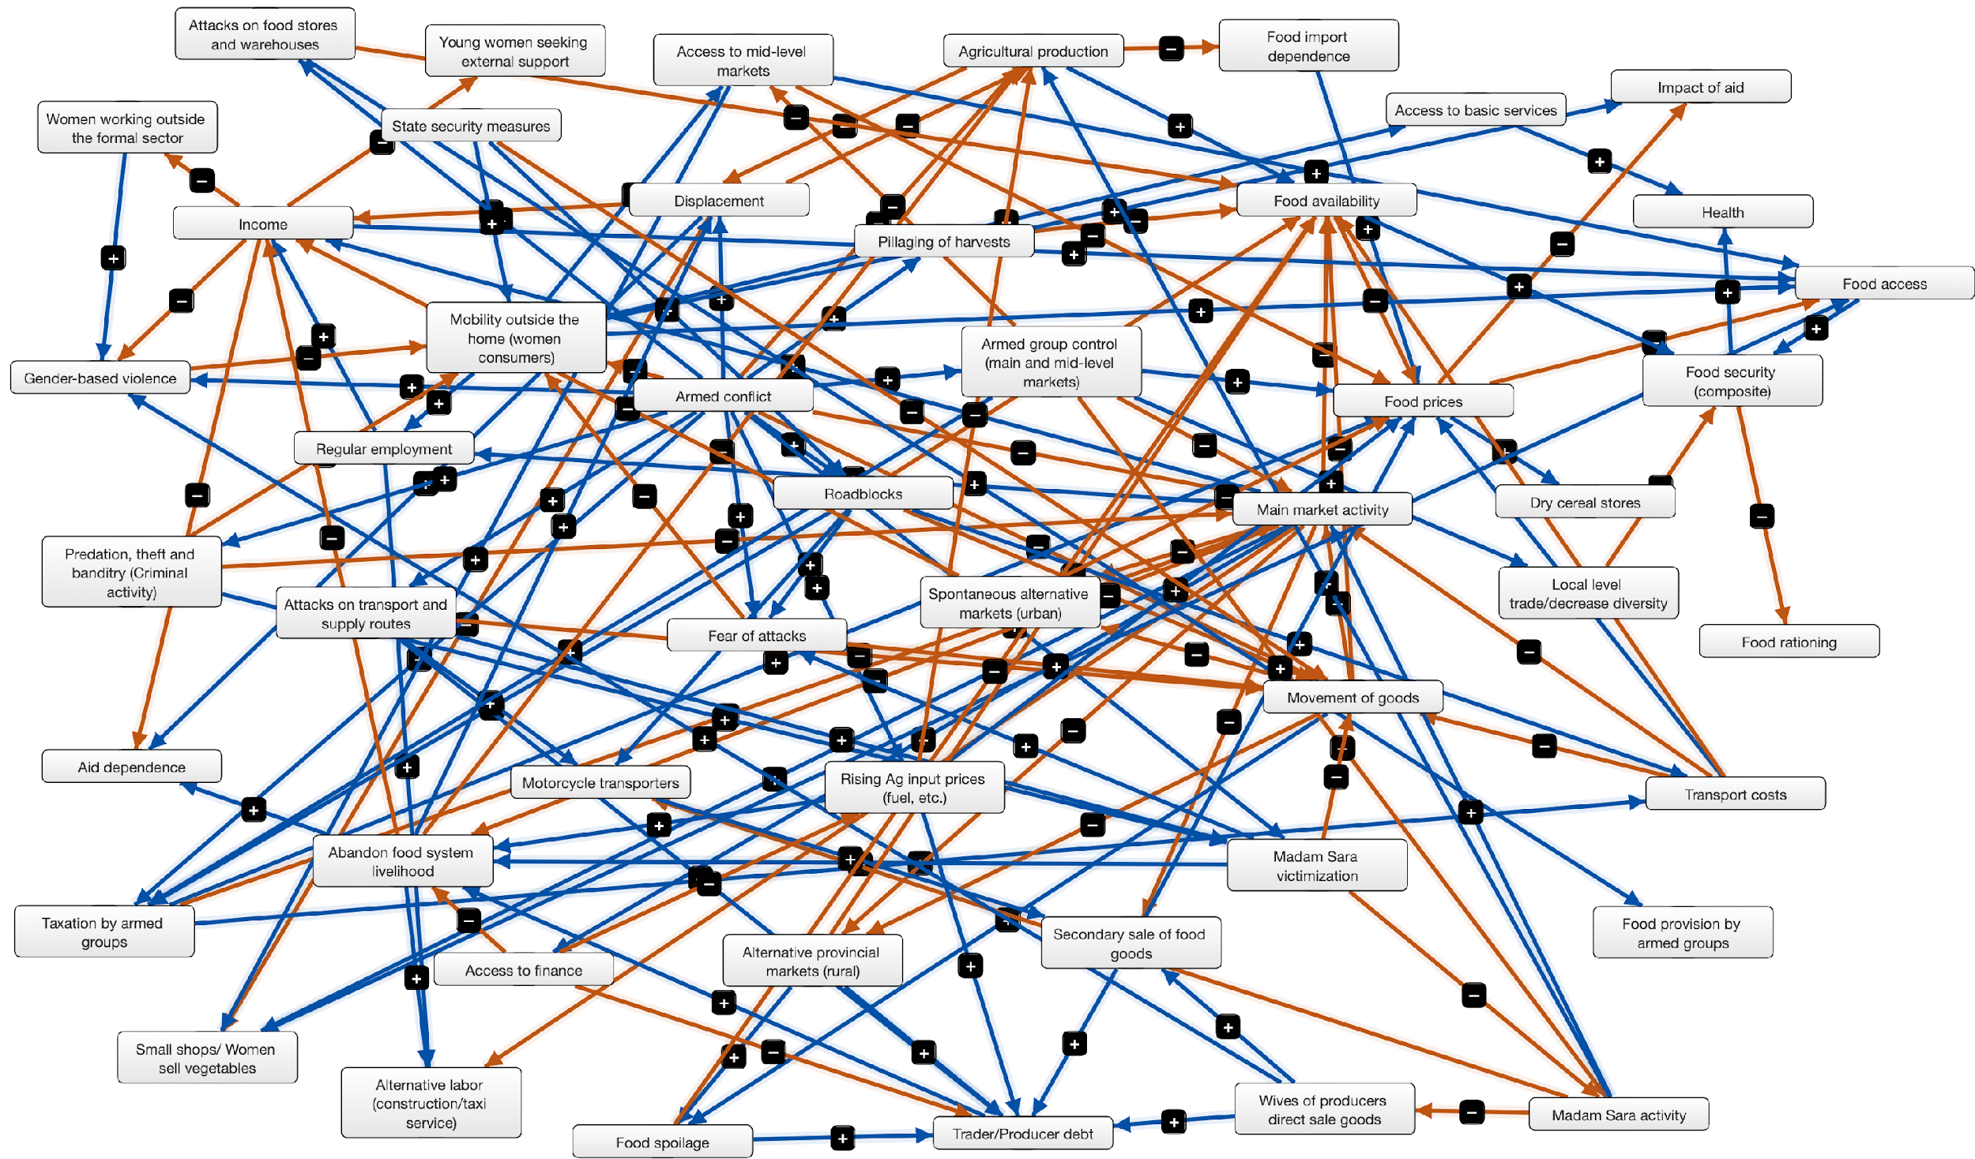
HAITI

Slide 8
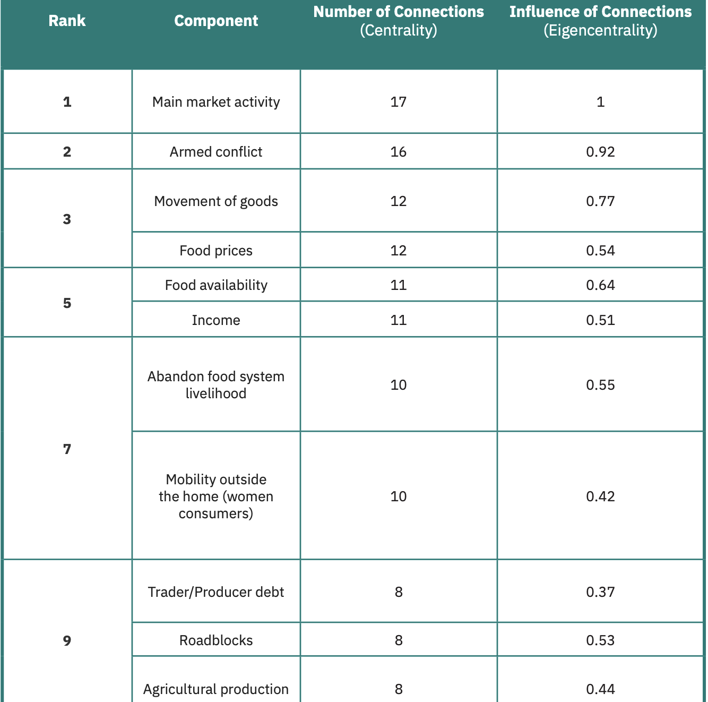
MOST CONNECTED FACTORS

Slide 9
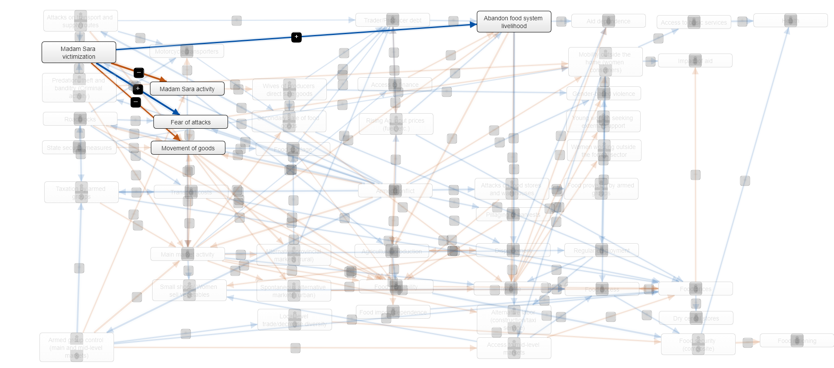
HAITI MAP: Madam Sara victimization
Notes:
Focus in our systems map on displacement: in addition to conflict more broadly, also driven by communal conflict, armed group recruitment and control over resources

Slide 10
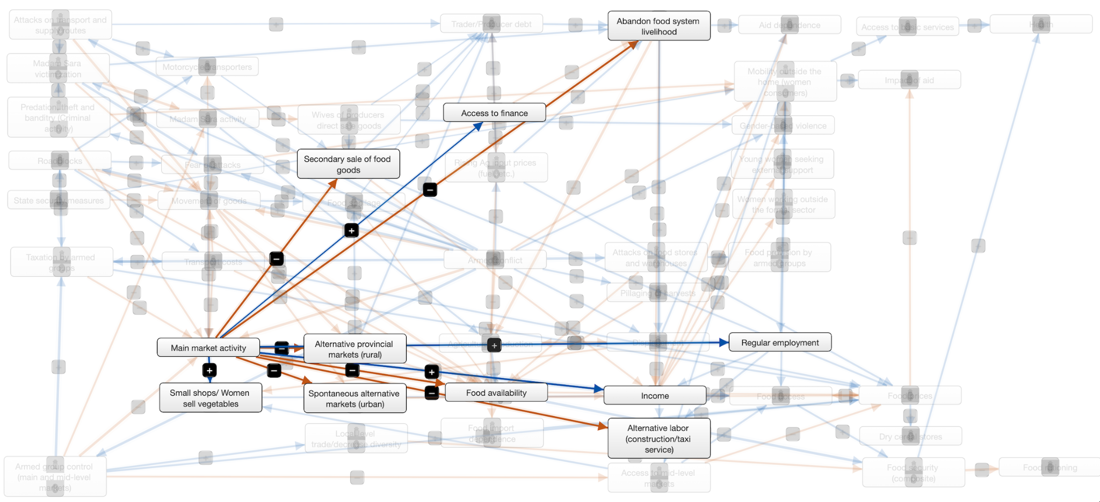
HAITI MAP: Central Market Impacts

Slide 11
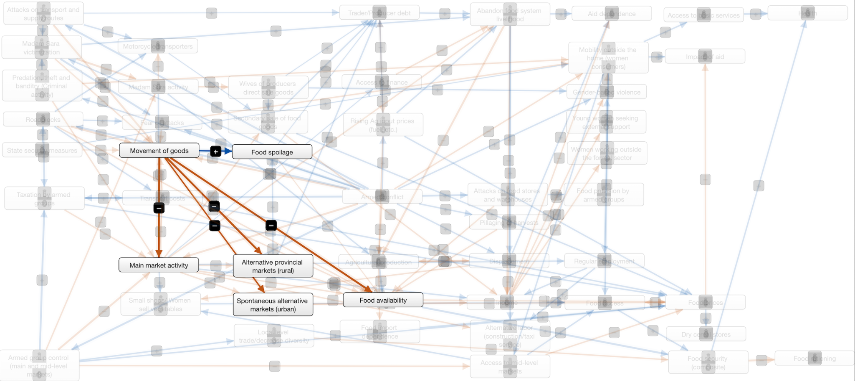
HAITI MAP: Impacts of movement of goods
Notes:
Focus in our systems map on displacement: in addition to conflict more broadly, also driven by communal conflict, armed group recruitment and control over resources

Slide 12
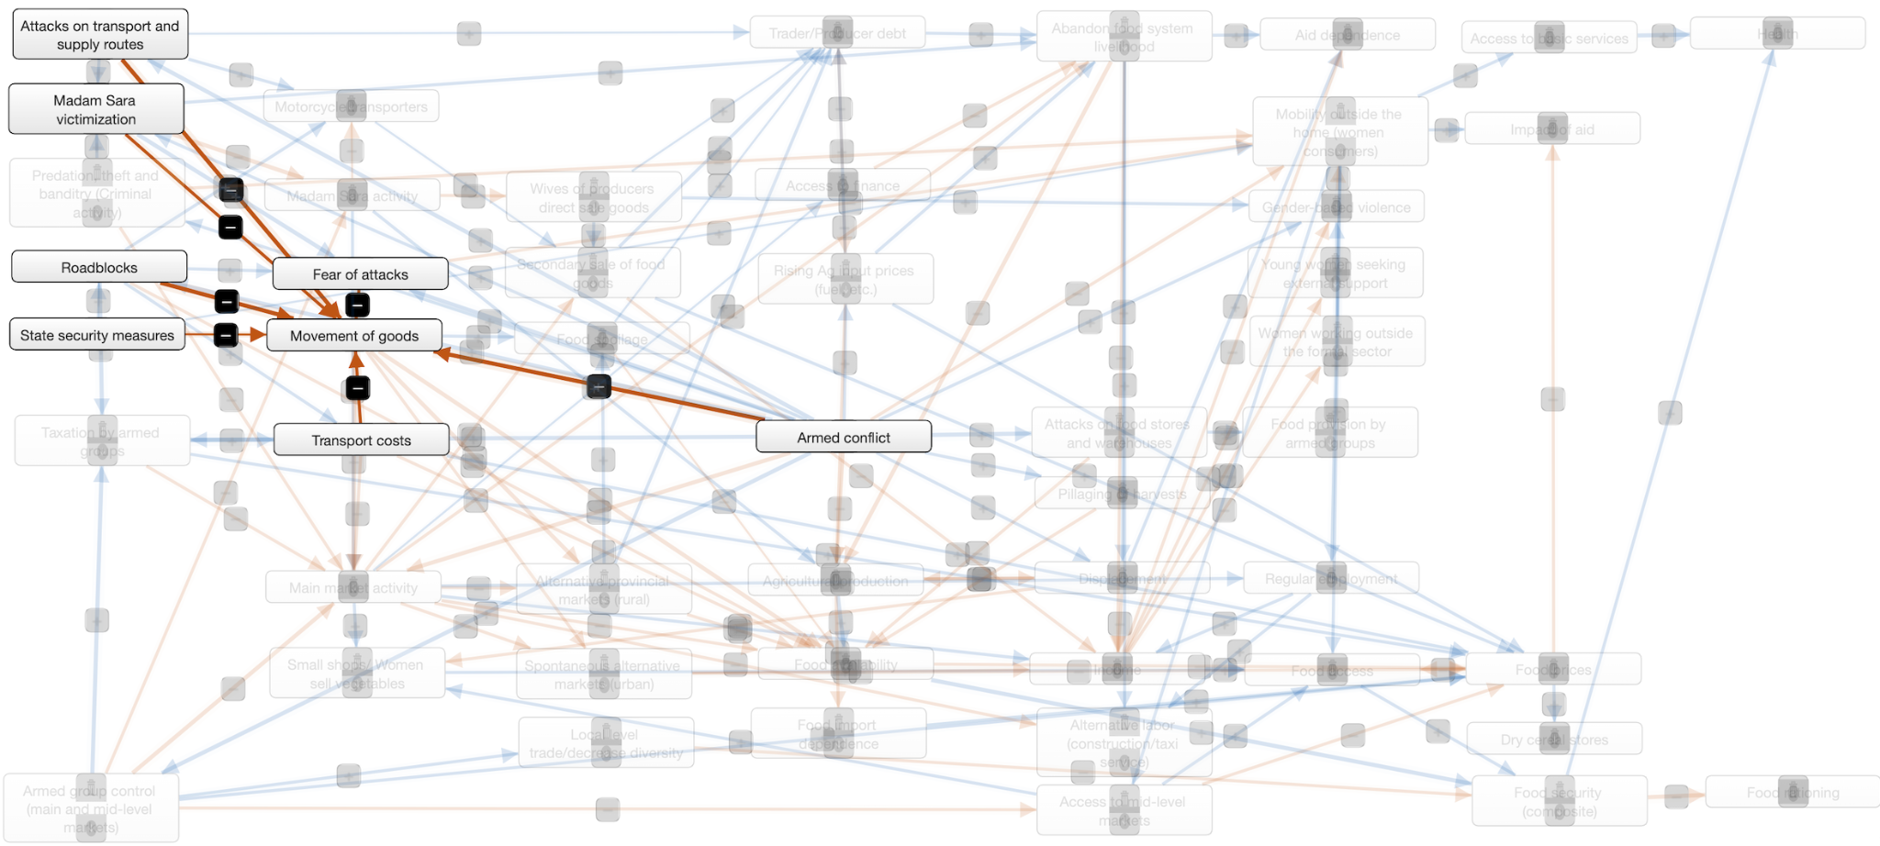
HAITI MAP: Factors impacting movement of gods
Notes:
Focus in our systems map on displacement: in addition to conflict more broadly, also driven by communal conflict, armed group recruitment and control over resources

Slide 13
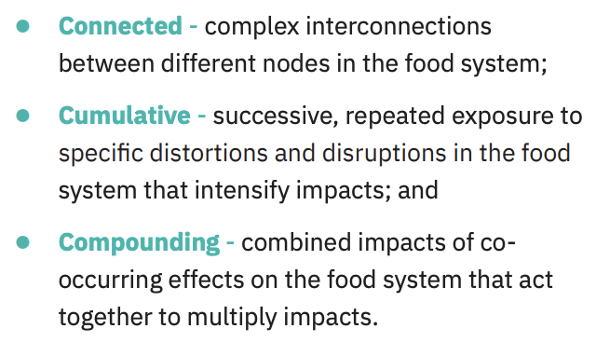
RESULTS:
CONNECTED, CUMULATIVE, COMPOUNDING
Notes:
Connected
Coping strategies are connected to food system impacts. Often the coping strategy used to deal with conflict navigates people into behavior that reduces local food production, availability and access. Using alternative markets, manual processing, local storage, changing crops, switching to bush products, selling food production assets, directly selling goods, and limiting purchases to local merchants are compensations that ultimately reduce the quantity of food in the system.
Connected
Imports and inflation must be connected to the larger local food system map and food security issues. Various imports can help or harm the food security and the relationships can be complex. Specific inputs such as seeds or fuel are critical to local food production and disruptions or increasing prices due to conflict or external factors strain the local food system. Food imports can be an important contribution for specific products to supplement local food production but their form, function and relative cost can be harmful. If they are of low quality calories such as processed carbohydrates, they can change diets and disincentivize local nutritious food. Additionally, if they are relatively lower priced and replace local foods directly they also disincentivize local food systems. Often they may be both lower priced and of lower nutritional quality. And finally, inflation may have a larger impact on food system inputs than the price of food imports to further tip the balance against local food production.
Connected
Host and IDP communities
As other humanitarian crisis research shows, host communities and IDPs, often have the same needs in the setting of crisis and food security in conflict reflects the same, with similar pressures bearing down on both populations aside from housing. But the surveys may point out that they experience or perceive differential immediate impacts on the food system perhaps as conflict in food production activities and locations cause displacement to urban areas that may not perceive the same initial impact or find processing and trade more greatly impacted.

Slide 14
RESULTS:
CONNECTED, CUMULATIVE, COMPOUNDING
Connected
Imports, inflation and local food
Notes:
Connected
Imports and inflation must be connected to the larger local food system map and food security issues. Various imports can help or harm the food security and the relationships can be complex. Specific inputs such as seeds or fuel are critical to local food production and disruptions or increasing prices due to conflict or external factors strain the local food system. Food imports can be an important contribution for specific products to supplement local food production but their form, function and relative cost can be harmful. If they are of low quality calories such as processed carbohydrates, they can change diets and disincentivize local nutritious food. Additionally, if they are relatively lower priced and replace local foods directly they also disincentivize local food systems. Often they may be both lower priced and of lower nutritional quality. And finally, inflation may have a larger impact on food system inputs than the price of food imports to further tip the balance against local food production.

Slide 15
RESULTS:
CONNECTED, CUMULATIVE, COMPOUNDING
Cumulative
Roadblocks, taxation and mobility
Gendered impacts
Notes:
Cumulative taxation and mobility:
Armed groups tax production, roadblocks and trade at markets. This burden combined with taxes from the government make food system activities prohibitively expensive or significantly diminish returns. Inputs into the food system, such as seeds, oil and fuel transports from Mogadishu are also illegally taxed by armed groups raising the cost of food production and processing.
Conflict related impacts on mobility are widespread but in combination have a devastating impact that, similar to taxes, reduces the flow of necessary inputs into the food system, hampers food trade, and compromises access to food.
Cumulative Gendered impacts
The pervasive impacts of conflict in the food system can be illustrated by their Gendered effects. Throughout the system there are specific impacts that disproportionately bear down on women and girls on top of the general impacts that affect everyone from manually processing food, wives of producers directly selling goods or using motorbikes to transport food in Haiti, venturing to alternative markets to purchase food for the family, and engaging in informal labor outside the home to supplement income. Many of these activities also expose them to gender-based violence. These are more pronounced in haiti given women’s critical role in the food system as Madam Saras.

Slide 16
RESULTS:
CONNECTED, CUMULATIVE, COMPOUNDING
Compounding
Maladaptive livelihood transformation and disabling local food systems
Health disruptions and specific risks for women and girls
Notes:
Coping strategies are connected to food system impacts. Often the coping strategy used to deal with conflict navigates people into behavior that reduces local food production, availability and access. Using alternative markets, manual processing, local storage, changing crops, switching to bush products, selling food production assets, directly selling goods, and limiting purchases to local merchants are compensations that ultimately reduce the quantity of food in the system.
Compounding
In addition to the cyclical relationship between conflict and food security as drivers of one another, food and livelihood systems are transformed by conflict into maladaptive states that undermine endogenous food systems and food security. Maladaptive cascades initiated by conflict lead to pathways that dimmish, degrade or disable local food systems. Displacement causes lost labor throughout food system related jobs from production to processing to transport and trade. Because of roadblocks, taxation and limited mobility, diminished trade and exchange within the system reduces flows of capital and intercommunal trade necessary for food system functioning. This lack of financing along with increasing risks to engaging in food related livelihoods, reduced returns and higher costs for agricultural and food system inputs such as seeds, fuel, fertilizer and necessary maintenance also dimmish re-investment in the food system. Other may sell food system assets such as livestock and equipment harming future food availability. In some cases, food system related livelihoods are abandoned altogether, and people transition away from food system related business and livelihoods into non-food-system related livelihoods. All these combined also drive the up the cost of local food compared to less nutritious imported food, disincentivizing local food production and changing diets toward imported foods.
Compounding
While conflict widely intersects the food system, supports fail to systematically address these impacts and cannot realize lasting benefits. Their absence compounds the initial consequences of conflict and allows the crippling of endogenous food systems. Aid can in some cases do harm as it can be more often urban based, incentivizing displacement. Food aid can often supplant local demand when import based. Cash transfers that are targeted only for consumption rather than food system related business and inputs to the food system do not allow the system to counter maladaptation. Failure at the state security level is mirrored in the public apparatuses that should provide some of this support in ministries and infrastructure or safety net programs. But other failures at the private level and lack of aid in financing for food system related businesses also compound this problem.
Health of women and girls
The direct impacts of conflict on the food system have significant and substantial indirect and multiplicative effects on health outcomes. Access to quality foods at necessary quantities is becoming increasingly rare in many parts of Haiti. As a result, rates of malnutrition and undernutrition are rising, particularly among children. As many livelihoods are tied to the food system, the damaging impacts on livelihoods documented throughout this study, lead to significantly reduced income, which is critical for accessing adequate shelter and basic needs as well as self-care, making it difficult to maintain health and wellbeing. Coping strategies employed in response to livelihood disruptions are also often specific to health, from skipping meals to forgoing medication and even basic hygiene.
Compounding this, the Haitian health care system is struggling to cope with the ongoing violent conflict. Disruptions to everyday life in Haiti, as described through this report, have significant and severe implications on the functioning of the healthcare system from lack of supplies, capacity and maintenance, and the ability of community members to seek and receive health care. This is particularly challenging in the context of limited mobility and inability to access health care centers for care. In combination with food system and livelihood disruptions, mounting health problems go unaddressed multiplying morbidity and mortality from a wide array of causes.
The disruptions in the food, livelihood and health systems are felt by all but bear down particularly for women and girls. Given the acute vulnerabilities they face, described earlier in this report, many of the common health impacts are more widely or severely felt by women and girls. Specifically, the increased conflict-related SGBV, reduced mobility and gendered impacts gravely affect the health of women and girls.

Slide 17
RECOMMENDATIONS
Pursue humanitarian relationships and diplomacy that understand and respond to the relationship between political dynamics, conflict dynamics, and food insecurity
Target women food system stakeholders for engagement in social cohesion activities.
Support nutrition-sensitive activities in secondary and tertiary markets.
Design targeted protection interventions that support vulnerable stakeholders in the food system.
Pursue humanitarian strategies that support local food systems and minimize negative externalities.
Pursue protection agenda and associated advocacy around cumulative impacts of taxation and mobility barriers (e.g., roadblocks).

Slide 18
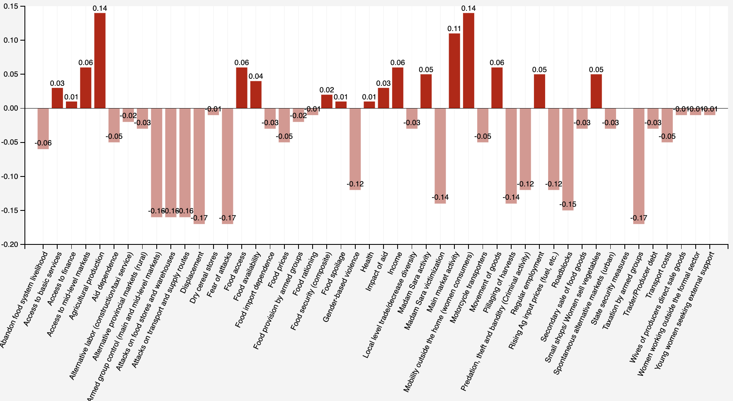
SCENARIO: If armed conflict were reduced…

Slide 19
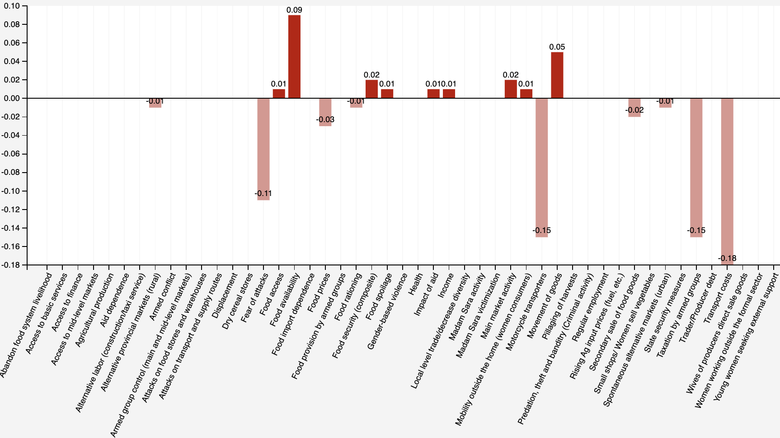
Scenario: If roadblocks reduced by 20%

Slide 20
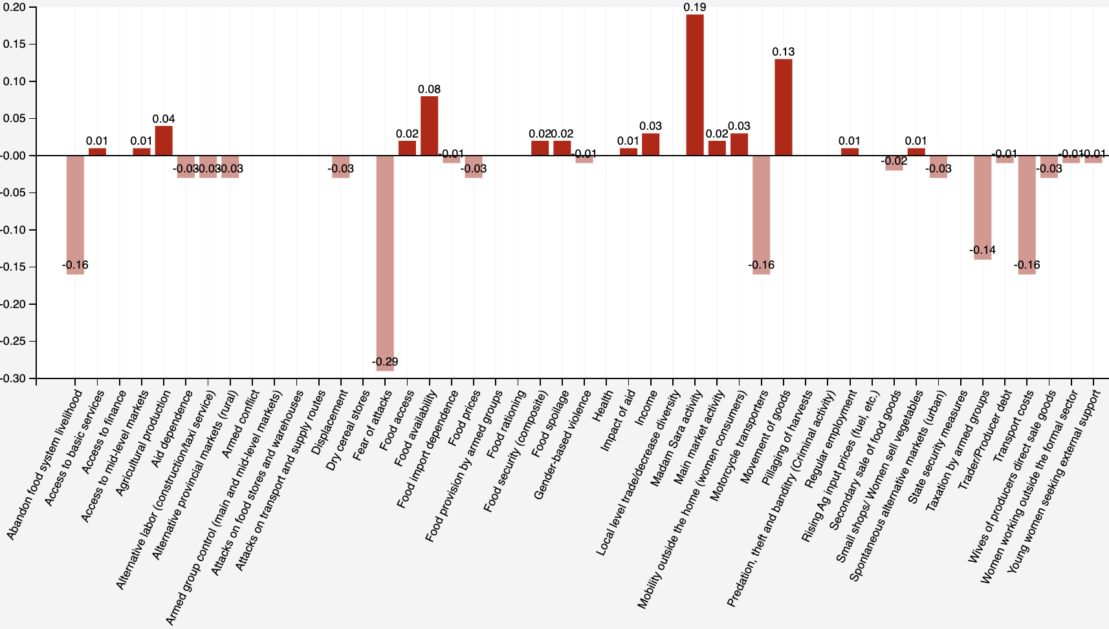
Scenario: Madam Sara + Roadblocks addressed

Slide 21
Thank you.

Slide 22
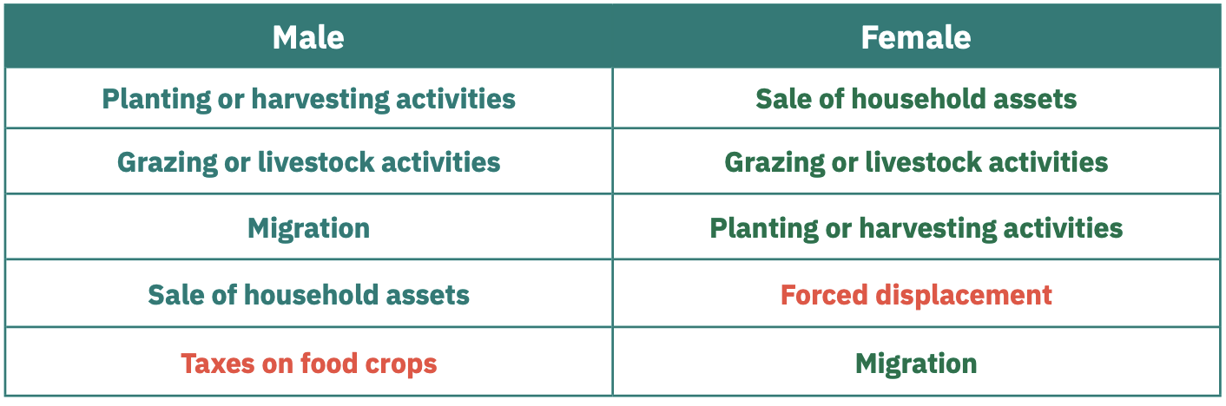
Most affected by conflict

