Slide 1
Displacement & Destruction: Analysis of Idlib, Syria 2017-2020
4 March 2020
Notes:
Citation | “Displacement and Destruction: Analysis of Idlib, Syria 2017-2020,” (4 March 2020) Signal Program on Human Security and Technology: Harvard Humanitarian Initiative, Cambridge, MA. Available at URL
The Signal Program on Human Security and Technology at the Harvard Humanitarian Initiative used very high-resolution satellite imagery produced by Maxar Technologies, also known as DigitalGlobe, to analyze the expansion of internally displaced person (IDP) camps and the destruction of towns in Idlib Governorate in Northeastern Syria. The sites were selected for imagery analysis given the availability and quality of imagery and the visibility of camp expansion; areas of destruction were identified through satellite imagery observations in Southern Idlib, corroborated by news reports of fighting in the region. The exact locations of the analyzed areas are intentionally withheld from this report.
***
The Signal Program on Human Security and Technology at Harvard Humanitarian Initiative is part of the Harvard T.H. Chan School of Public Health. Since 2012, the Signal Program has advanced the safe, ethical, and effective use of information communication technologies by communities of practice during humanitarian and human rights emergencies. Harvard Humanitarian Initiative conducts research and education to empower communities in crisis. Learn more at https://hhi.harvard.edu/research/signal. Press contact: Caitlin Howarth, chowarth@hsph.harvard.edu, (617) 384-5640.

Slide 2
Areas of Interest
The Signal Program on Human Security and Technology at the Harvard Humanitarian Initiative used very high-resolution satellite imagery collected between 2017 and 26 February 2020 from Maxar Technologies, also known as DigitalGlobe, to analyze the expansion of internally displaced person (IDP) camps and the destruction of towns in Idlib Governorate in North-West Syria.
As the Syrian war enters its tenth year, the following satellite imagery analysis illustrates how parts of the Syrian landscape have dramatically changed through bombardment, conflict, and civilian displacement. This analysis provides a limited view of the realities on the ground; at this stage, it primarily focuses on what can be determined via imagery. The analyzed sites represent a portion of the camps and towns and do not show the full extent of all areas; the figures generated from this analysis only correspond to the sites shown. Sites were selected for public-facing analysis based on several factors, including: the availability and quality of imagery; the visibility of camp expansion; and corroborating reports of fighting in the region. Sections of larger towns were excluded from this report based on preliminary analysis that identified concerns for civilian protection. The exact locations of the regions analyzed are intentionally withheld from this report.

Slide 3
What Can (and Can’t) Be Seen
It is important to note that those most exposed to the elements, without any form of tarping or shelter, cannot be clearly perceived via the commercial-grade imagery available to humanitarians and NGOs.
OCHA and aid organizations estimate that 60 percent of IDPs are children, and that tens of thousands are exposed and without shelter.
Image ©2016 World Vision/photo by Jon Warren
Notes:
Image ©2016 World Vision/photo by Jon Warren

Slide 4
Key Findings
Analysts found that the size of the two analyzed IDP camp sites increased approximately 100% and 177% between 27 September 2017 and 26 February 2020 – nearly doubling and tripling in size.
In February 2020, there are indicators of planned structure expansion in both IDP camps, as noted by the construction of building foundations. There are large additions of small informal structures along the edges of the analyzed camps.
Damage assessments conducted in two towns devastated by fighting in southern Idlib suggested that approximately 30% of the structures were entirely or partially destroyed.

Slide 5
Displacement
The imagery captures changes visible in parts of two IDP camps across four dates between September 2017 and February 2020, which will be referred to as IDP Displacement Camp A and B. Analysts noted substantial changes at both locations, particularly pertaining to size, structure density, and physical feature characteristics. Structure density appears to grow acutely by 2019 compared to previous years. The clearly apparent increase in structure density is consistent with UN OCHA estimates that more than 948,000 Syrians have been displaced in northwest Syria since 1 December 2019, and that available shelters have been eclipsed by current need. Sixty percent of those displaced during that period were children; shelter is the most urgently identified need. The rapid rate of displacement instigated by the ongoing bombardment of populated civilian areas and infrastructure, including schools, compounds acute and overwhelming needs throughout this region.

Slide 6
Displacement Camp A, Idlib Governorate

Slide 7
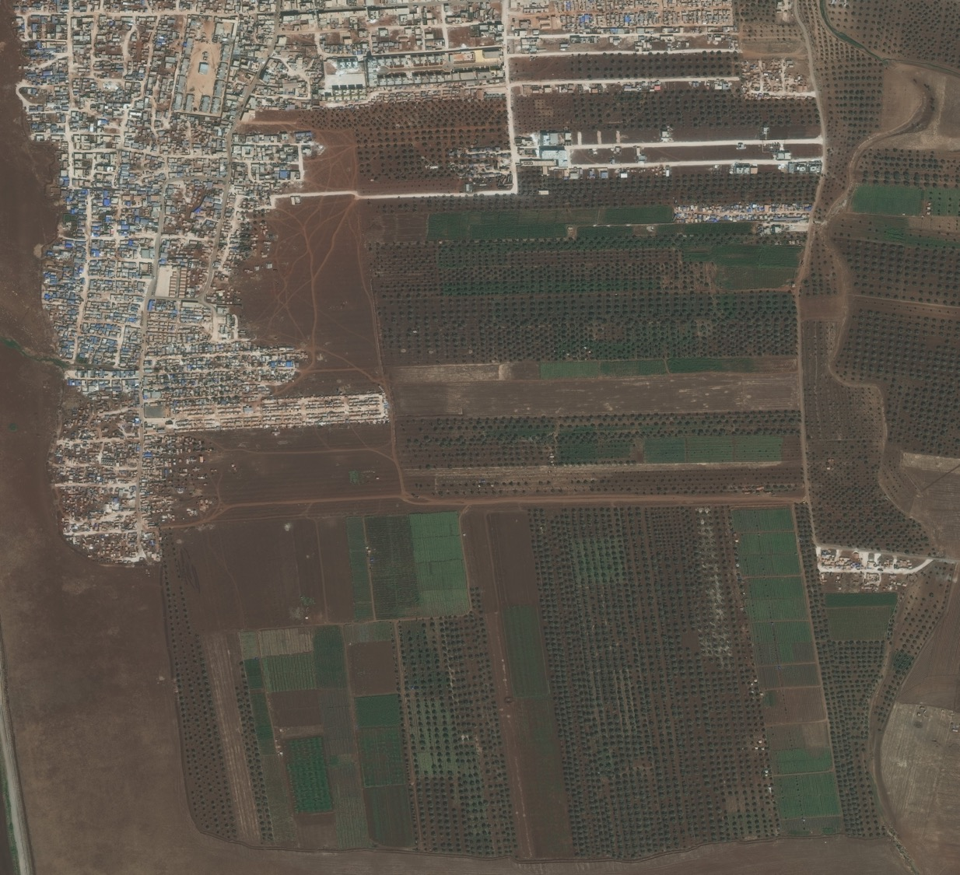
In September 2017, the IDP camp established to date was primarily concentrated in the NW of the image and was in close proximity to agricultural fields to the east. The structures appear heterogeneous in size, coloring, and material. Large parts of the camp appear to be formalized and organized, and there are road connections visible in close proximity to the densely settled areas.
Around the edges of the camp, particularly in the SW, there is a concentration of unorganized, smaller, informal structures. This cluster of structures is consistent with a self-settled and spontaneous camp. Singular informal structures are also visible in the agricultural fields around the camp.
Informal structures
Notes:
Satellite imagery © 2020 DigitalGlobe
Fig 1.a. IDP Camp, Idlib Governorate Satellite imagery acquired 27 September 2017

Slide 8
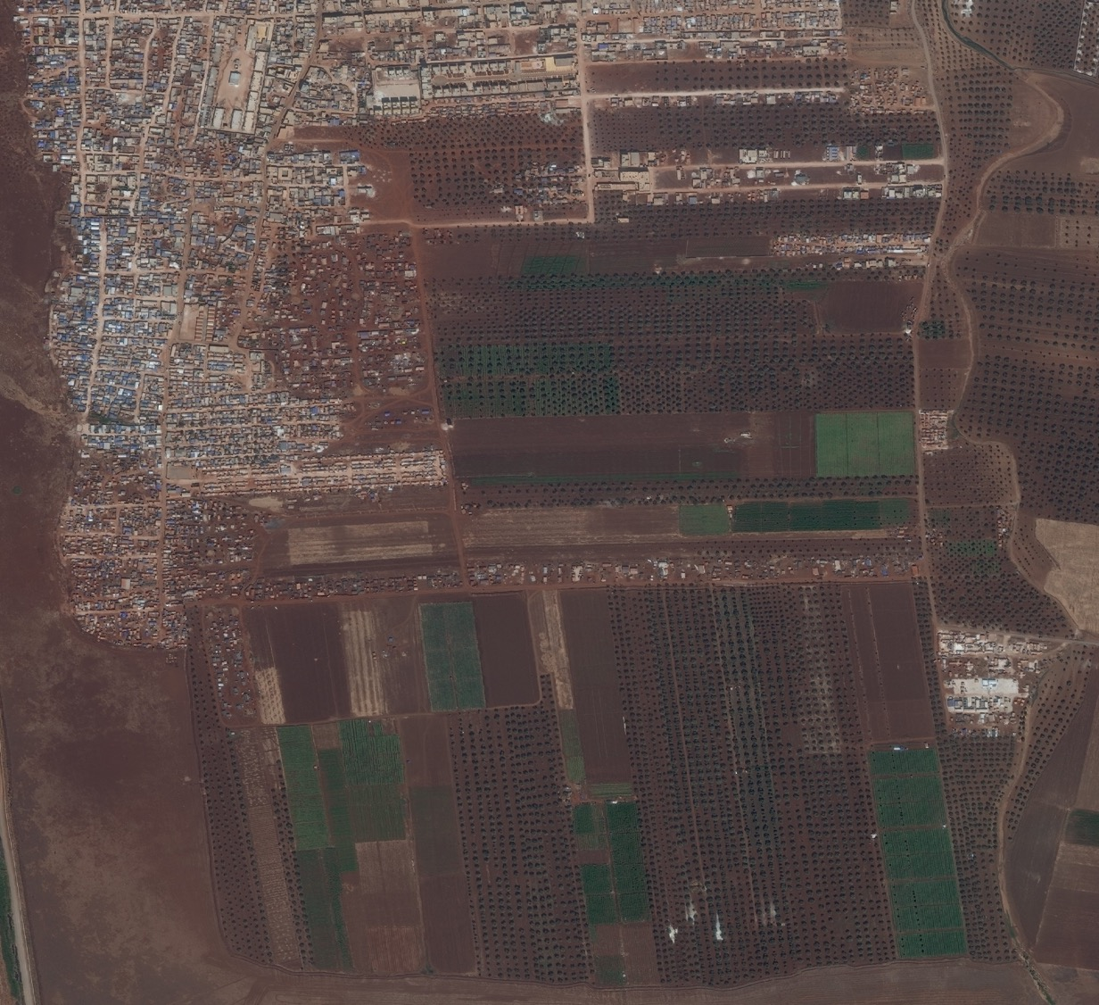
In September 2018, additional self-settled populations lined the edges of the established camp in large numbers. These newly added structures resemble the informal structures previously seen bordering the southern parts of the camp in September 2017. The added temporary structures between 2017 and 2018 appear smaller compared to the older, more well-established parts of the camp. There are no established road networks, and there is little apparent organization of visible structures; this may be consistent with recent arrivals.
The road networks visible in both September 2017 and 2018 are increasingly bordered by development in 2018.
Additional Settlement
Additional Settlement
Notes:
Satellite imagery © 2020 DigitalGlobe
Fig 1.b. IDP Camp, Idlib Governorate Satellite imagery acquired 26 September 2018

Slide 9
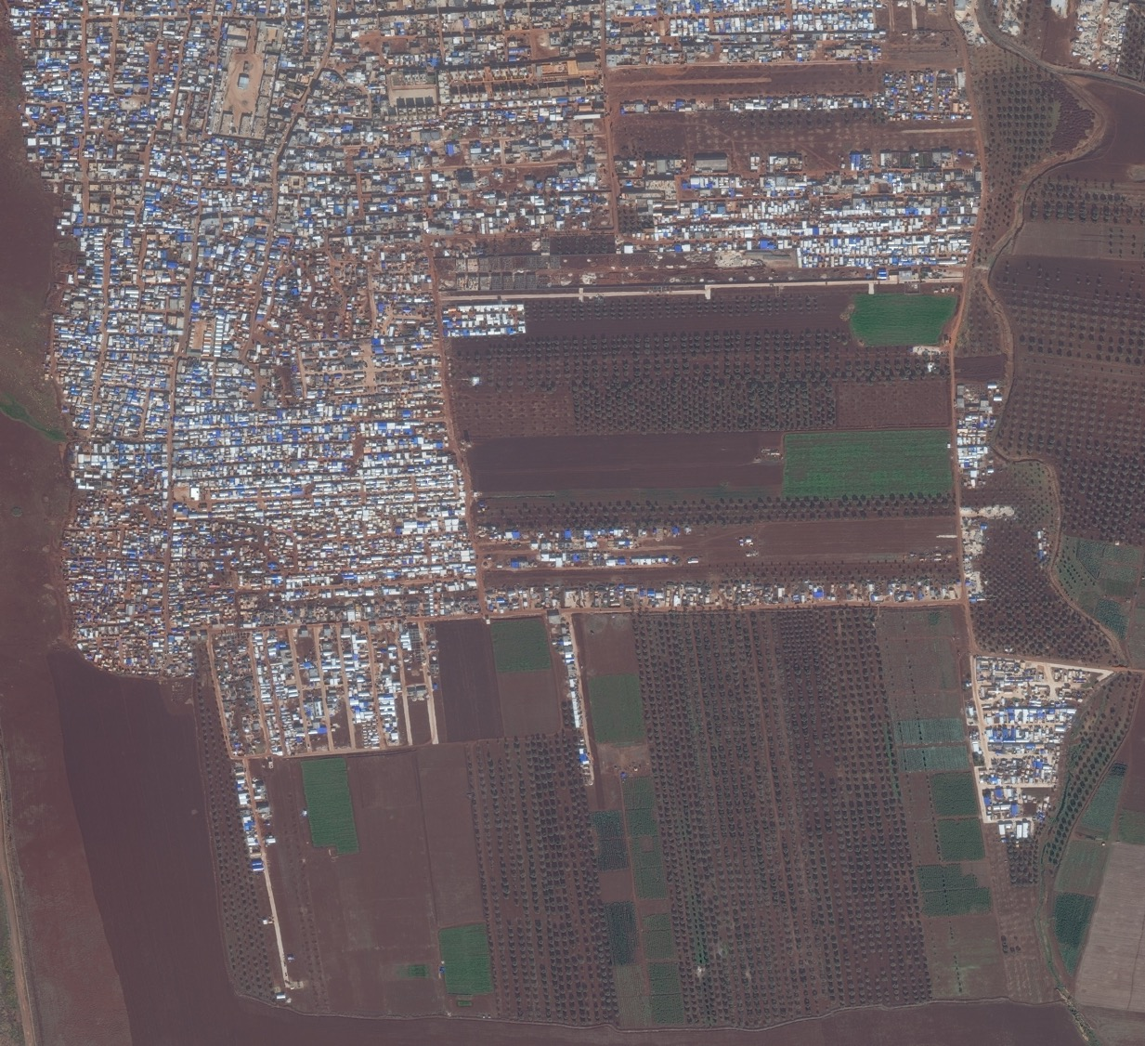
Between 2018 and 2019, the same areas that expanded with informal settlement the prior year became more formalized. The temporary structures visible in 2018 appear to have been replaced by larger, more permanent structures with sturdy roofing by 2019. The expansion continues to take over former agricultural fields; the removal of orchard trees may indicate further planned expansion.
Agriculture Loss
Settlement Formalization
Expansion
Expansion
Notes:
Satellite imagery © 2020 DigitalGlobe
Fig 1.c. IDP Camp, Idlib Governorate Satellite imagery acquired 2 December 2019
PULL 2nd graf to final image in this set

Slide 10
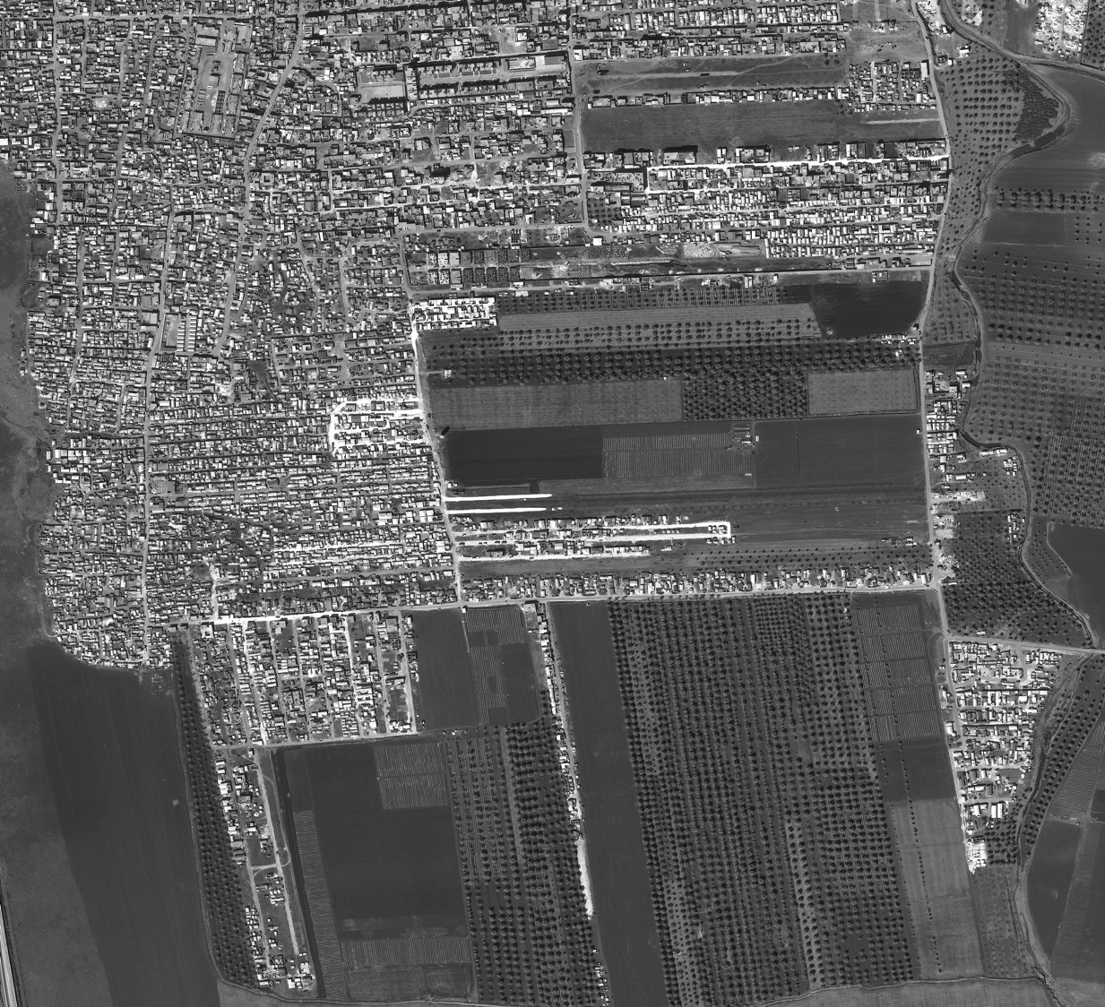
Between December 2019 and February 2020, additional construction is visible. New building foundations have been laid, and several structures that were undergoing construction in December 2019 have roofs by February 2020.
There are also several structures without roofing in December 2019 that are not completed by February 2020.
Expansion
Expansion
Notes:
Satellite imagery © 2020 DigitalGlobe
Fig 1.d. IDP Camp, Idlib Governorate Satellite imagery acquired 26 February 2020

Slide 11
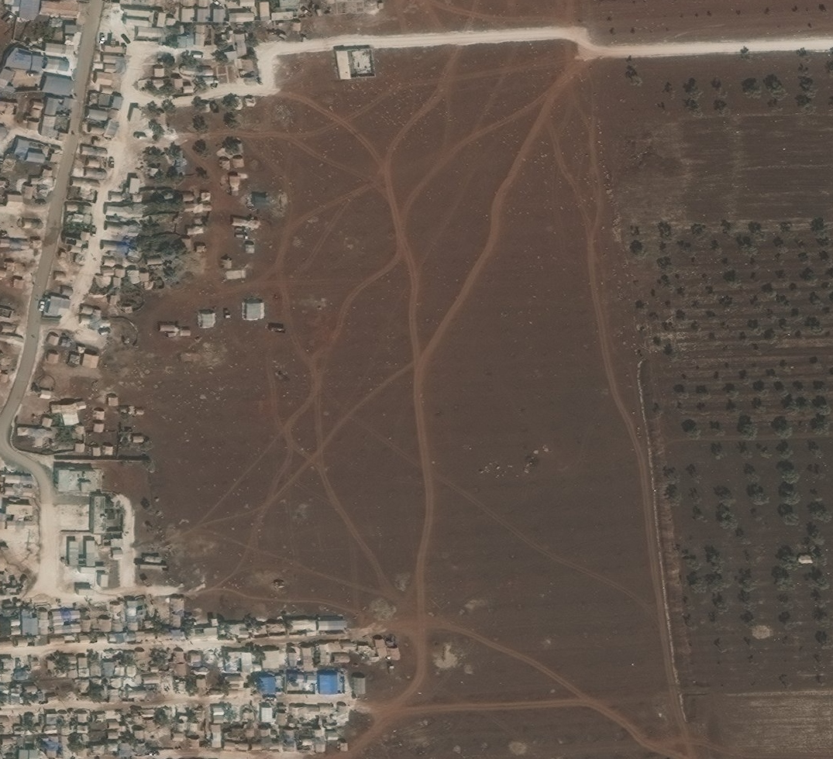
The structures throughout displacement camp A are heterogeneous in size, coloring, and material. Agricultural fields border large parts of the camp, and here there is a clearing in between. Track marks are visible, but the space is not occupied by structures.
Fig 2.a. IDP Camp, Idlib Governorate 27 September 2017
Satellite imagery ©2020 DigitalGlobe
Tracking
Agriculture
Notes:
Satellite imagery © 2020 DigitalGlobe
Fig 2.a. IDP Camp, Idlib Governorate Satellite imagery acquired 27 September 2017

Slide 12
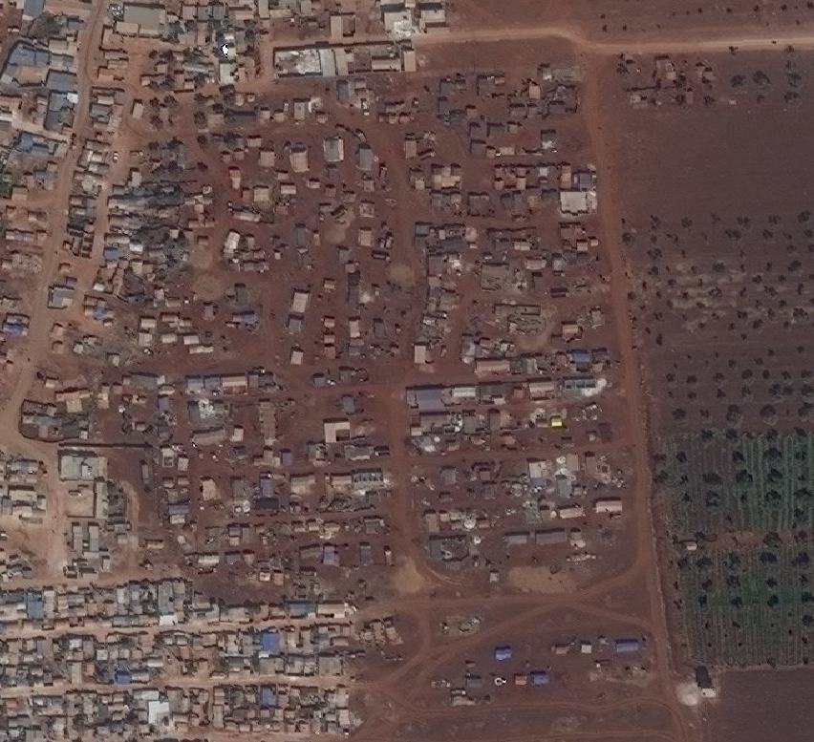
By September 2018, the previously empty space becomes occupied by several structures consistent with the physical characteristics of a self-settled and spontaneous camp. Several structures appear among the trees beyond the previously unoccupied space.
Fig 2.b. IDP Camp, Idlib Governorate 26 September 2018
Satellite imagery ©2020 DigitalGlobe
New structures
Notes:
Satellite imagery © 2020 DigitalGlobe
Fig 2.b. IDP Camp, Idlib Governorate Satellite imagery acquired 26 September 2018

Slide 13
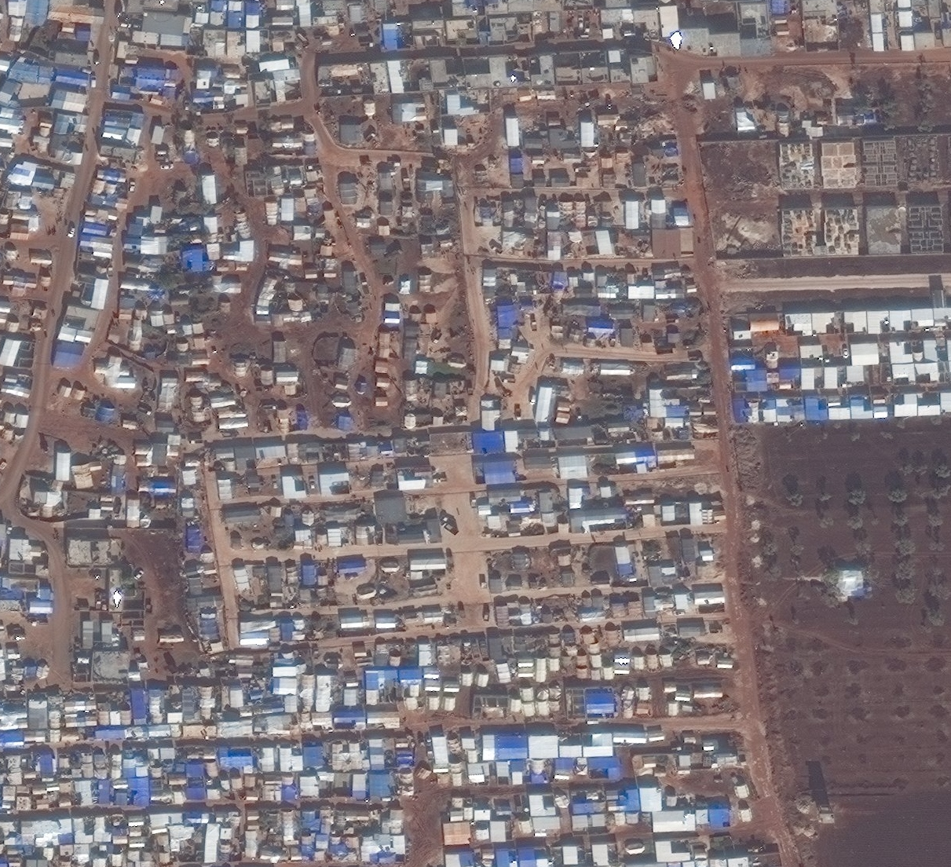
The temporary structures visible in 2018 appear to have been replaced by larger, more permanent structures with sturdy roofing by December 2019. The area becomes more densely occupied and expansion toward the east replaces agricultural fields still visible in the image captured in September 2018.
Fig 2.c. IDP Camp, Idlib Governorate 2 December 2019
Satellite imagery ©2020 DigitalGlobe
New Construction
Agricultural Displacement
Notes:
Satellite imagery © 2020 DigitalGlobe
Fig 2.c. IDP Camp, Idlib Governorate Satellite imagery acquired 2 December 2019

Slide 14
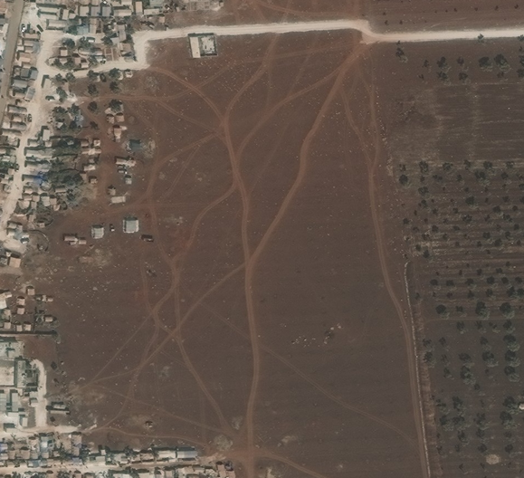
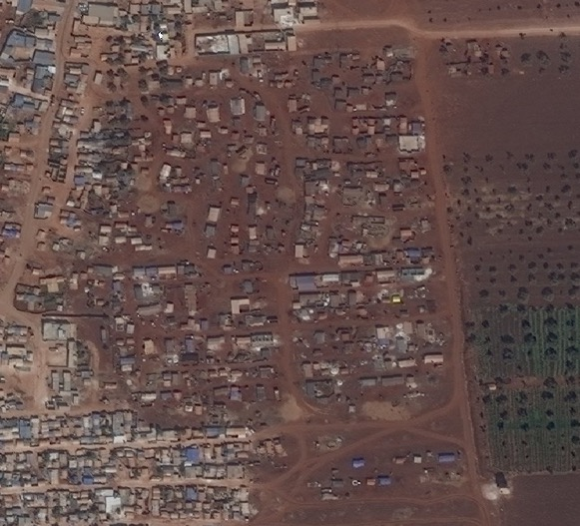
27 September 2017
26 September 2018
2 December 2019
Fig 2.d. Informal to Formal IDP Camp Expansion, Idlib Governorate Composite of Figs 2a/b/c. Satellite imagery acquired 27 September 2017 (2.a), 26 September 2018 (2.b), 2 December 2019 (2.c).
Satellite imagery ©2020 DigitalGlobe
Notes:
Satellite imagery © 2020 DigitalGlobe
Fig 2.d. Informal to Formal IDP Camp Expansion, Idlib Governorate Composite of Figs 2a/b/c. Satellite imagery acquired 27 September 2017 (2.a), 26 September 2018 (2.b), 2 December 2019 (2.c).

Slide 15
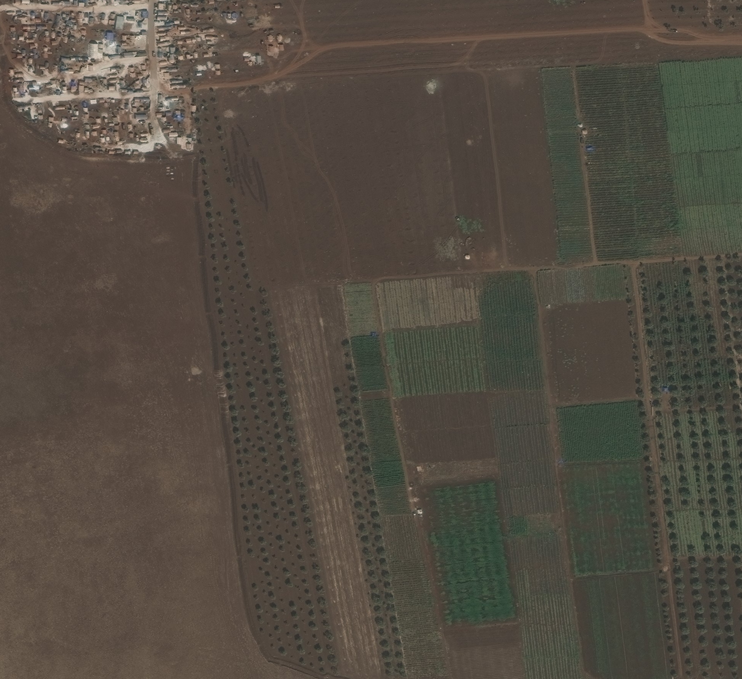
In September 2017, there is a concentration of informal structures in the SW of the camps, near agricultural fields. Several structures are visible throughout the farmed land.
Fig 3.a. IDP camp site and agricultural land, Idlib Governorate 27 September 2017
Satellite imagery ©2020 DigitalGlobe
Informal structures
Notes:
Satellite imagery © 2020 DigitalGlobe
Fig 3.a. IDP camp site and agricultural land, Idlib Governorate Satellite imagery acquired 27 September 2017

Slide 16
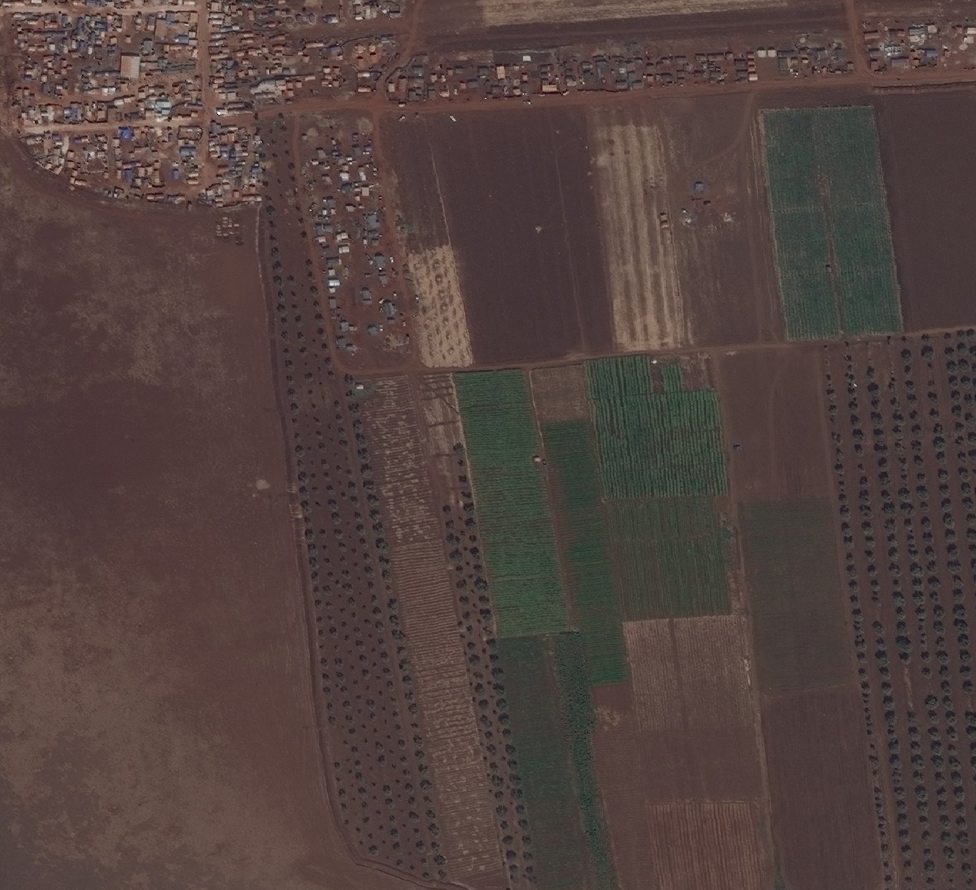
By September 2018, there has been a substantial increase of self-settled populations based close to and often on land that appeared to have formerly been used for agriculture.
Fig 3.b. IDP camp site expansion into agricultural land, Idlib Governorate 26 September 2018
Satellite imagery ©2020 DigitalGlobe
Expansion
Notes:
Satellite imagery © 2020 DigitalGlobe
Fig 3.b. IDP camp site expansion into agricultural land, Idlib Governorate Satellite imagery acquired 26 September 2018

Slide 17
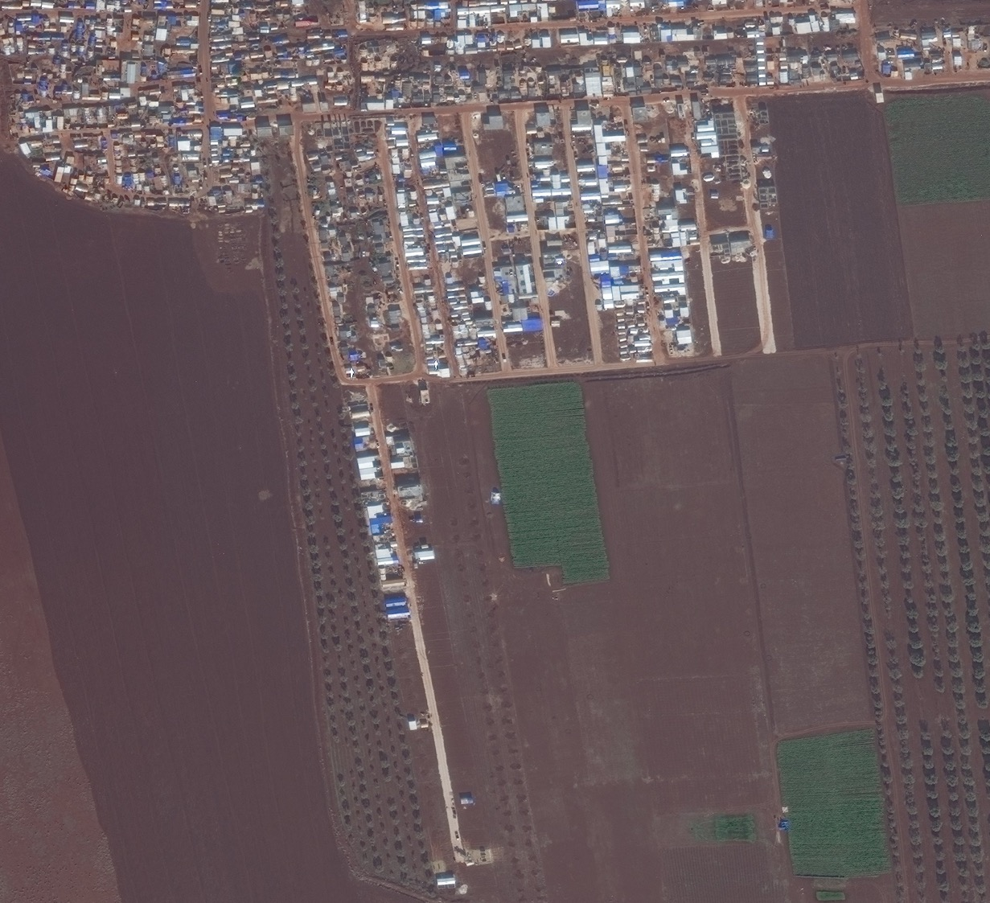
By December 2019, the landscape has substantially changed. The change is consistent with increased structure density, structure formalization, camp expansion, and conversion of agricultural land.
Fig 3.c. IDP camp site formalization, expansion into agricultural land, Idlib Governorate 2 December 2019
Satellite imagery ©2020 DigitalGlobe
Increased structure density
Increased structure density
Formalized structures, expansion
Expansion
Notes:
Satellite imagery © 2020 DigitalGlobe
Fig 3.c. IDP camp site formalization, expansion into agricultural land, Idlib Governorate Satellite imagery acquired 2 December 2019

Slide 18
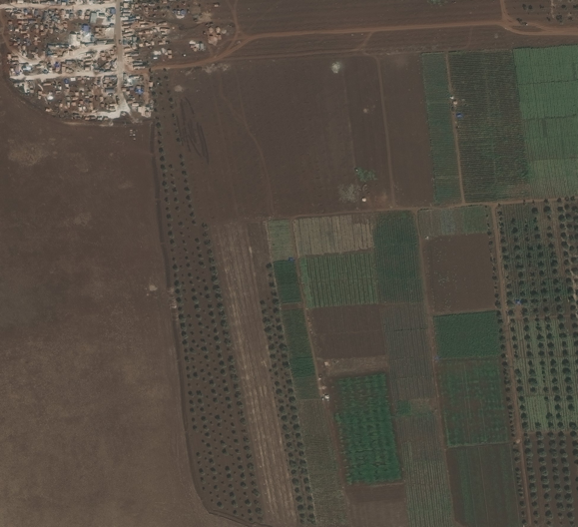
27 September 2017
26 September 2018
2 December 2019
Fig 3.d. IDP camp expansion into former agricultural land, 2017-2019, Idlib Governorate Composite of Figs 3a/b/c. Satellite imagery acquired 27 September 2017 (3.a), 26 September 2018 (3.b), 2 December 2019 (3.c).
Satellite imagery ©2020 DigitalGlobe
Notes:
Satellite imagery © 2020 DigitalGlobe
Fig 3.d. IDP camp expansion into former agricultural land, 2017-2019, Idlib Governorate Composite of Figs 3a/b/c. Satellite imagery acquired 27 September 2017 (3.a), 26 September 2018 (3.b), 2 December 2019 (3.c).

Slide 19
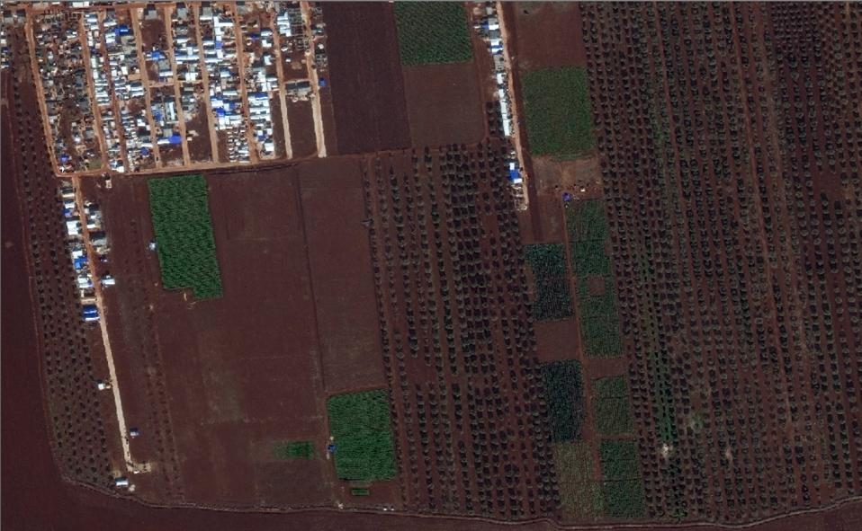
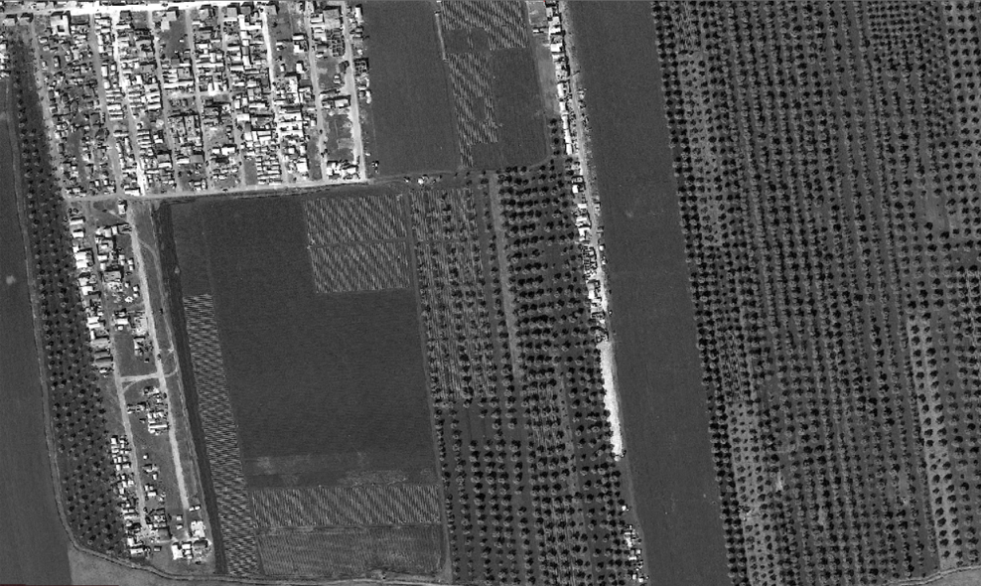
Structure density increase
Significant expansion
2 December 2019
26 February 2020
Fig 3.e. IDP camp expansion into former agricultural land over 86 days, Dec 2019 – Feb 2020, Idlib Governorate In less than three months, structure density and settlement area expands significantly. IDPs who may be sheltering among agriculture groves, without tarps or other cover, cannot be identified using satellite imagery alone. The apparent expansion may underrepresent the real population growth at this site.
Satellite imagery ©2020 DigitalGlobe

Slide 20
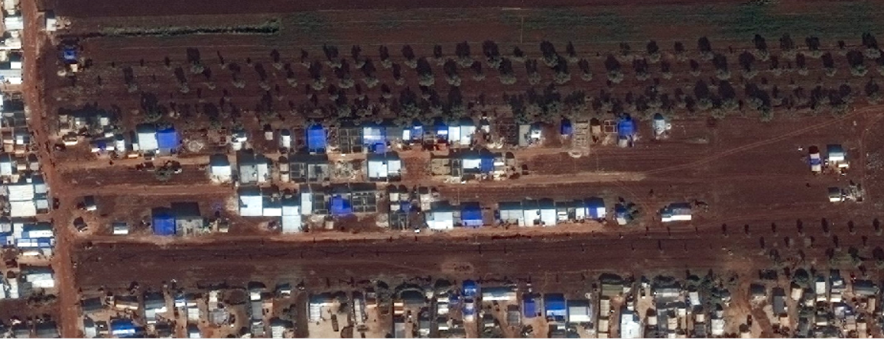
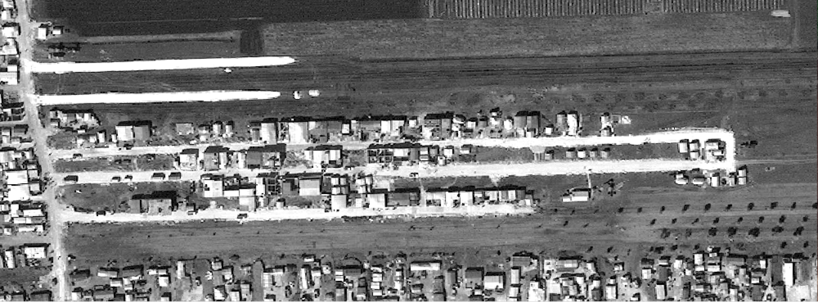
Fig 3.f. IDP camp expansion into former agricultural land.
2 December 2019
Increased development, loss of agriculture
26 February 2020
Notes:
Fig 3.f. IDP camp expansion into former agricultural land.
Satellite imagery ©2020 DigitalGlobe

Slide 21
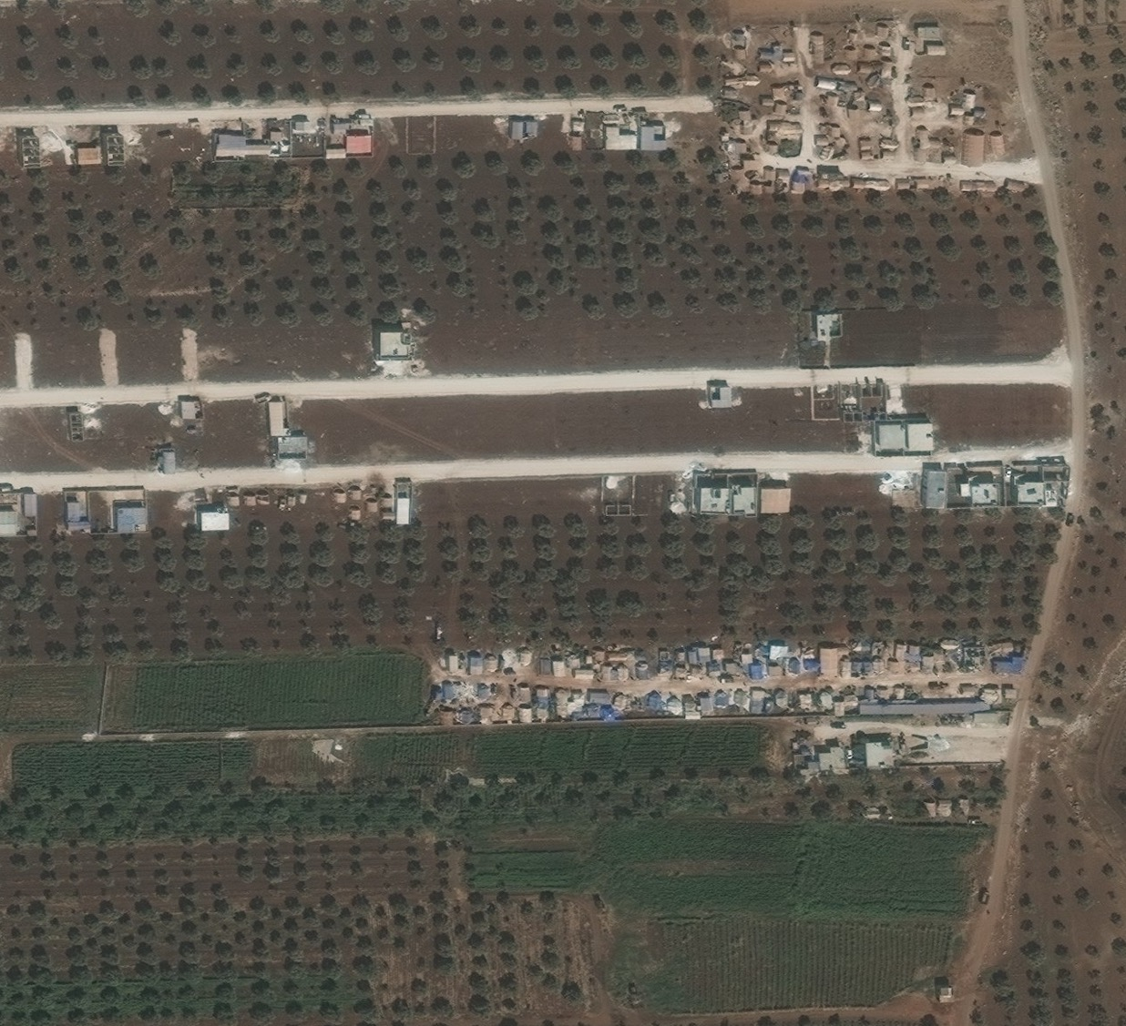
Parts of the camp appear to be formalized and organized, with apparent connecting roads throughout.
Fig 4.a. IDP camp site and agricultural land, Idlib Governorate 27 September 2017
Satellite imagery ©2020 DigitalGlobe
Notes:
Satellite imagery © 2020 DigitalGlobe
Fig 4.a. IDP camp site and agricultural land, Idlib Governorate Satellite imagery acquired 27 September 2017

Slide 22
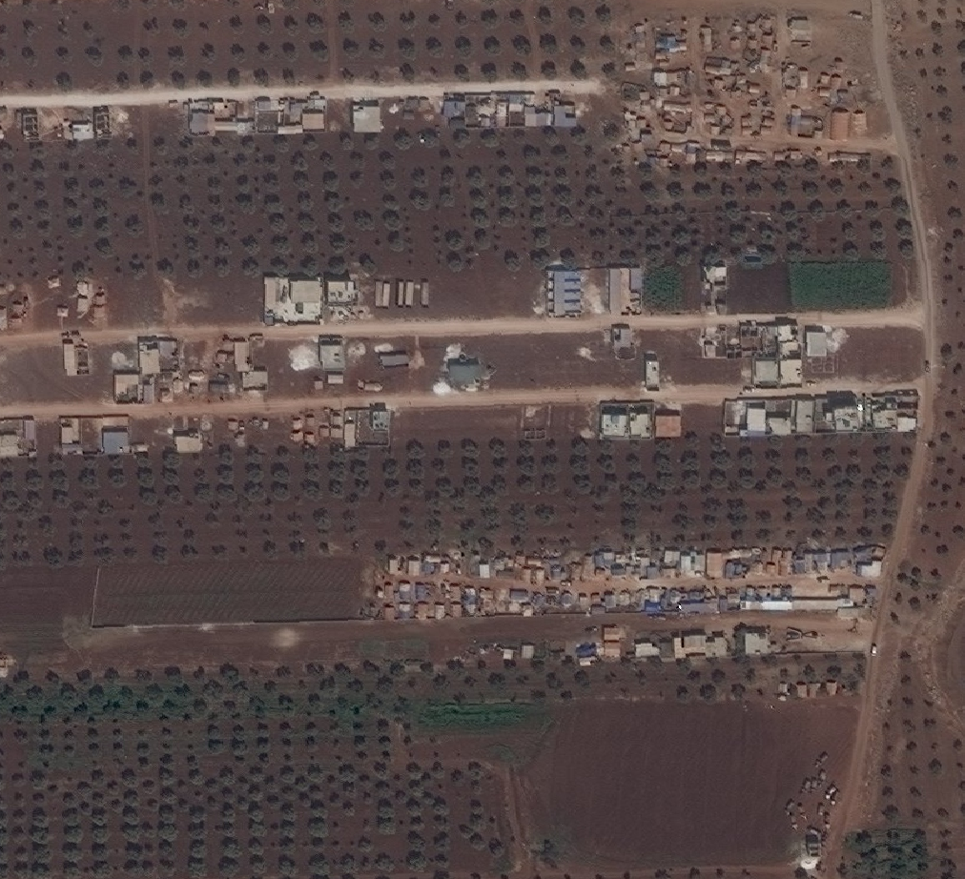
By September 2018, areas that were previously unoccupied appear to be undergoing construction and there appears to be additional small structures clustered in various areas.
Fig 4.b. IDP camp site expansion into agricultural land, Idlib Governorate 26 September 2018
Satellite imagery ©2020 DigitalGlobe
Notes:
Satellite imagery © 2020 DigitalGlobe
Fig 4.b. IDP camp site expansion into agricultural land, Idlib Governorate Satellite imagery acquired 26 September 2018

Slide 23
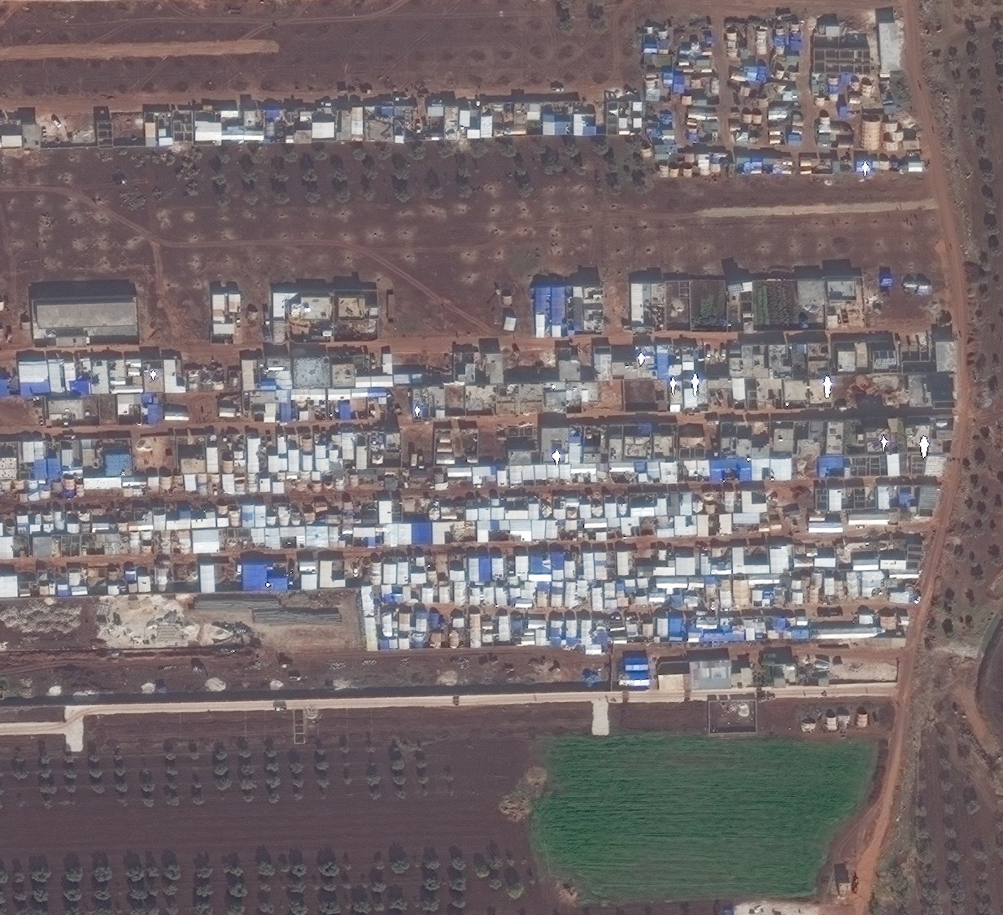
As seen in previous figures, by December 2019 there appears to be substantial formalization of structures as well as additional development. Where trees previously stood in September 2018 now mirror physical characteristics that are consistent with upturned earth, suggest that the trees may have been removed.
Fig 4.c. IDP camp site formalization, expansion into agricultural land, Idlib Governorate 2 December 2019
Satellite imagery ©2020 DigitalGlobe
Notes:
Satellite imagery © 2020 DigitalGlobe
Fig 4.c. IDP camp site formalization, expansion into agricultural land, Idlib Governorate Satellite imagery acquired 2 December 2019

Slide 24
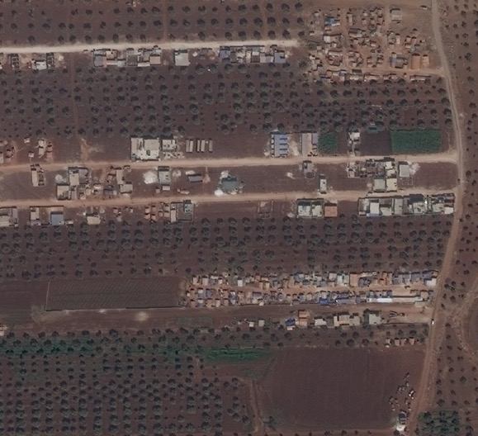
27 September 2017
26 September 2018
2 December 2019
Fig 4.d. IDP camp expansion into former agricultural land, 2017-2019, Idlib Governorate Composite of Figs 4a/b/c. Satellite imagery acquired 27 September 2017 (3.a), 26 September 2018 (3.b), 2 December 2019 (3.c).
Satellite imagery ©2020 DigitalGlobe
Notes:
Satellite imagery © 2020 DigitalGlobe
Fig 4.d. IDP camp expansion into former agricultural land, 2017-2019, Idlib Governorate Composite of Figs 4a/b/c. Satellite imagery acquired 27 September 2017 (3.a), 26 September 2018 (3.b), 2 December 2019 (3.c).

Slide 25
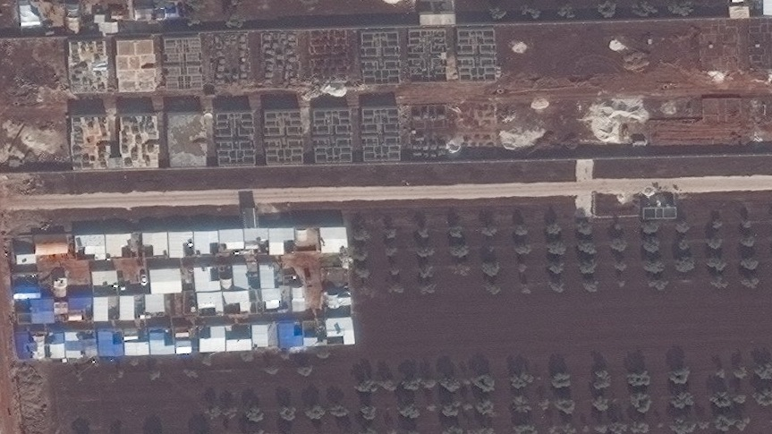
Fig 5. Construction of new structures underway, Idlib Governorate | 2 December 2019
Additional building foundations are also visible: outside walls and room divisions are visible, and a roof does not appear to have been placed. The length of the shadows cast by the structures are considerably tall and could potentially be more than one story in height.
Notes:
Satellite imagery © 2020 DigitalGlobe
Fig 5. Construction of new structures underway, Idlib Governorate 2 December 2019
Additional building foundations are also visible: outside walls and room divisions are visible, and a roof does not appear to have been placed. The length of the shadows cast by the structures are considerably tall and could potentially be more than one story in height.

Slide 26
Displacement Camp B, Idlib Governorate

Slide 27
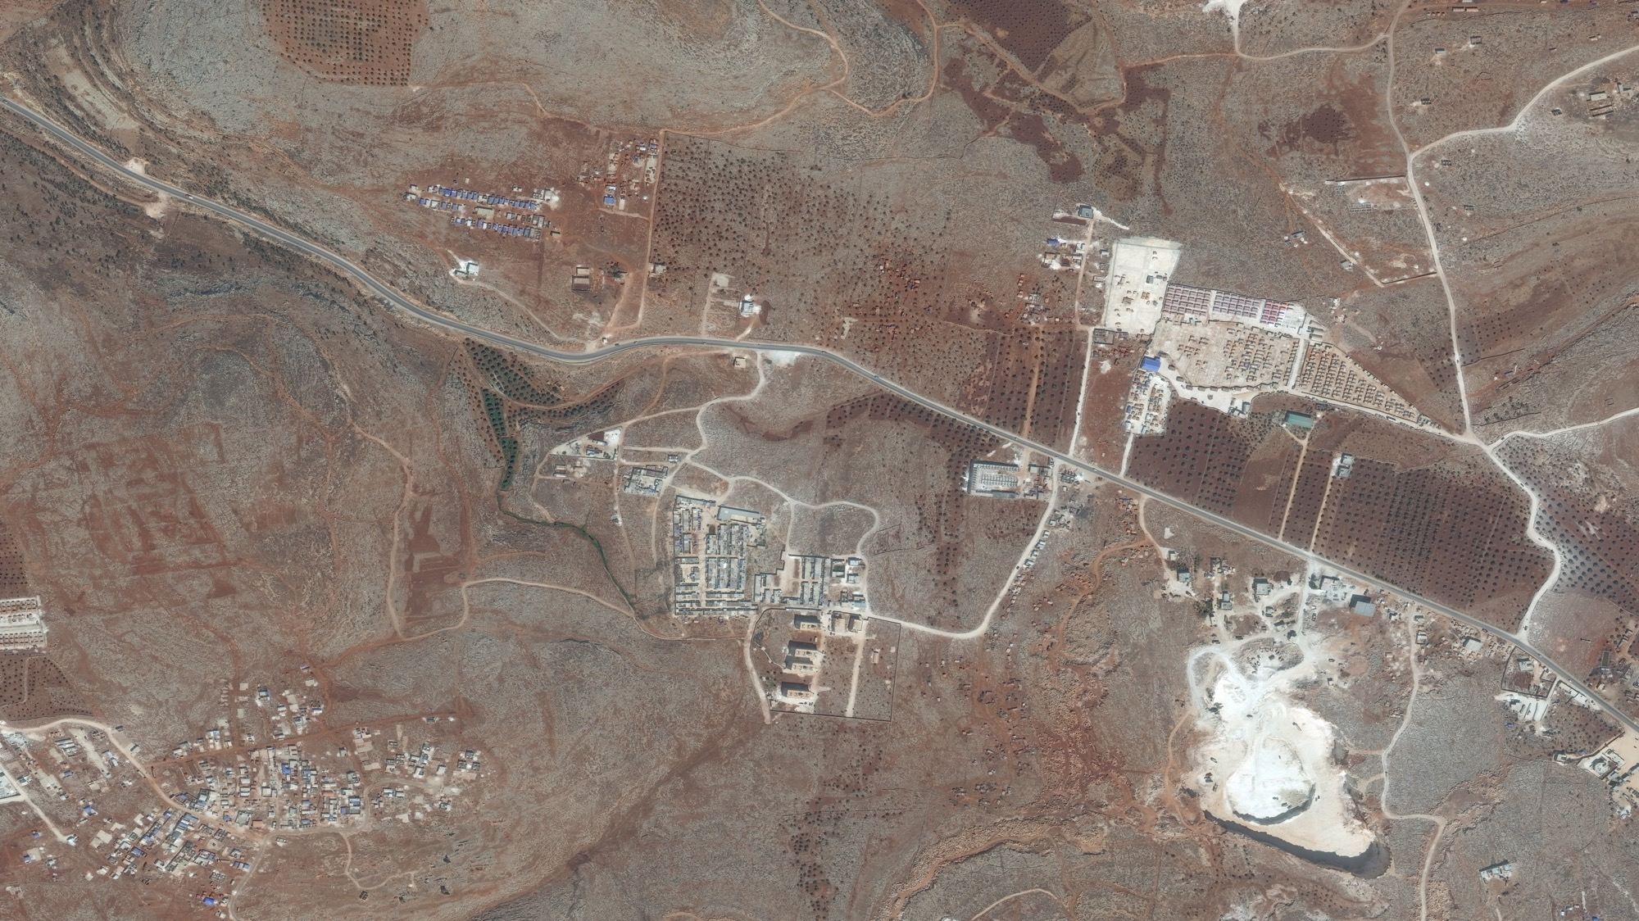
Fig 6.a. Displacement camp B, Idlib Governorate 27 September 2017
Notes:
Satellite imagery © 2020 DigitalGlobe
Fig 6.a. IDP camp, Idlib Governorate 27 September 2017

Slide 28
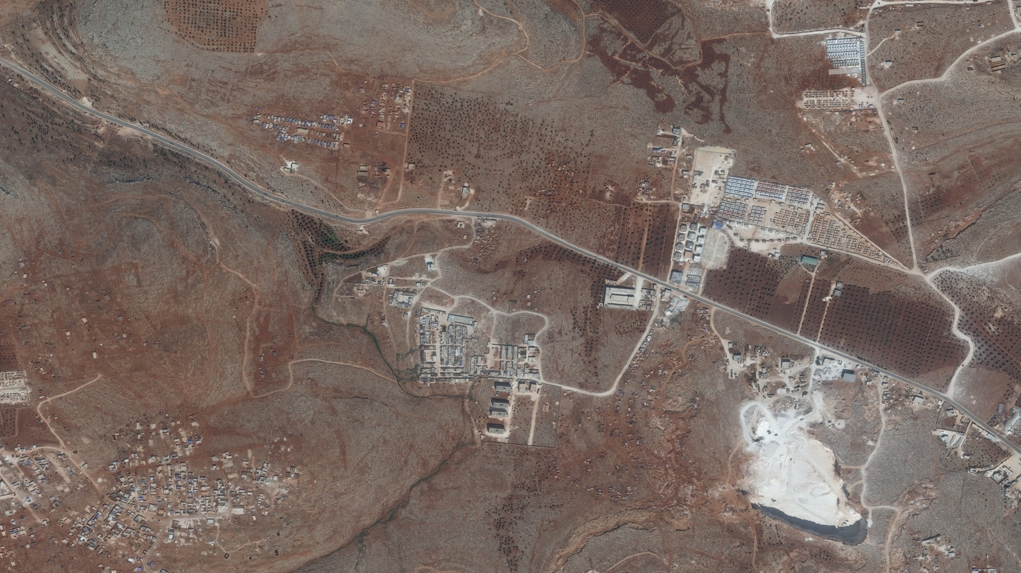
Fig 6.b. Displacement camp B, Idlib Governorate 27 September 2017
Notes:
Satellite imagery © 2020 DigitalGlobe
Fig 6.b. IDP camp expansion of informal settlements, Idlib Governorate Satellite imagery acquired 26 September 2018

Slide 29
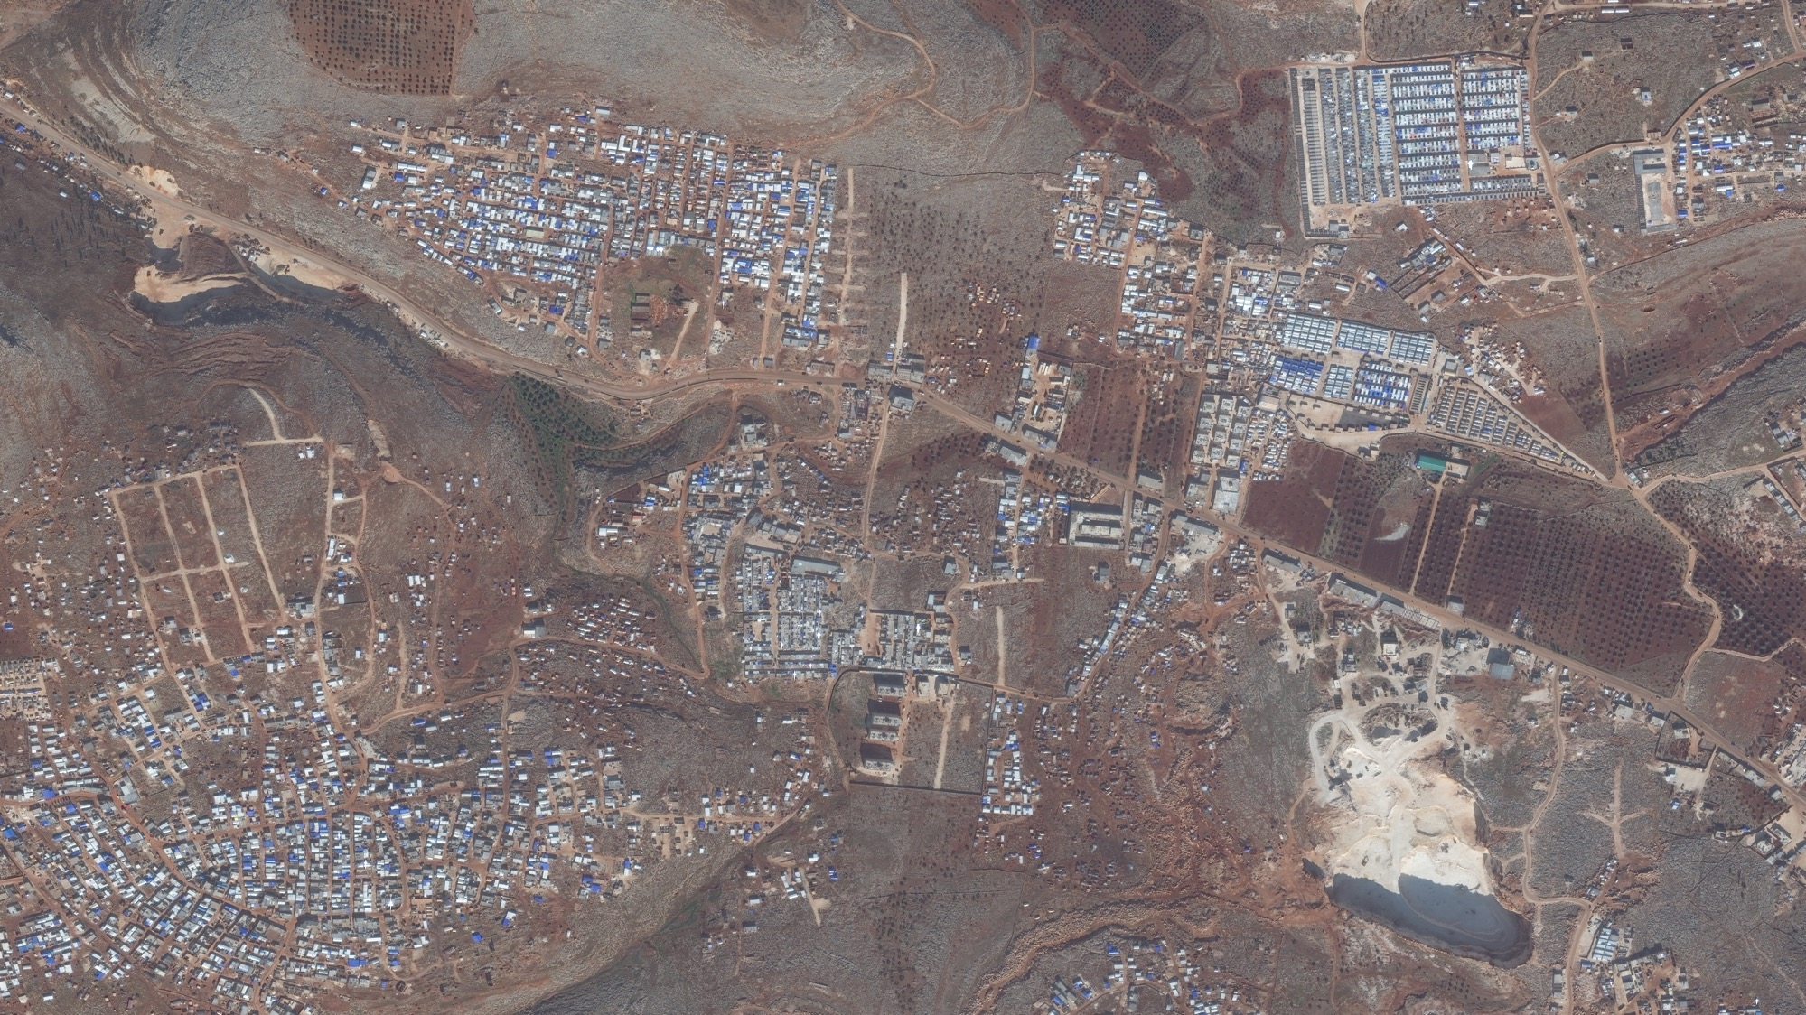
Fig 6c. Displacement camp B, Idlib Governorate 27 September 2017
Notes:
Satellite imagery © 2020 DigitalGlobe
Fig 6.c. IDP camp formalization, expansion, and density increase, Idlib Governorate Satellite imagery acquired 2 December 2019

Slide 30
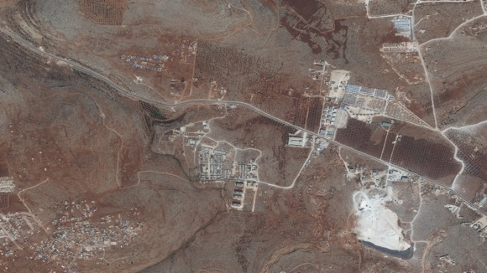
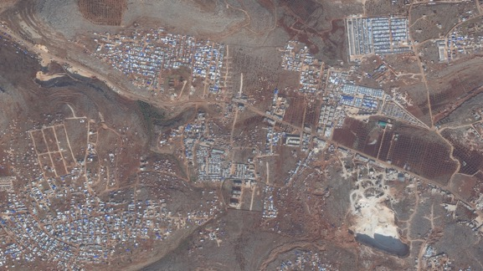
27 September 2017
26 September 2018
2 December 2019
Fig 6.d. IDP camp formalization, expansion, and density increase, Idlib Governorate Although growth is apparent between 2017 and 2018, by 2 December 2019 this site has expanded at a far more rapid pace consistent with reports of IDP influx.
Satellite imagery ©2020 DigitalGlobe
Notes:
Satellite imagery © 2020 DigitalGlobe
Fig 6.d. IDP camp formalization, expansion, and density increase, Idlib Governorate Composite of Figs 6.a/b/c. Satellite imagery acquired 27 September 2017 (6.a), 26 September 2018 (6.b), 2 December 2019 (6.c).

Slide 31
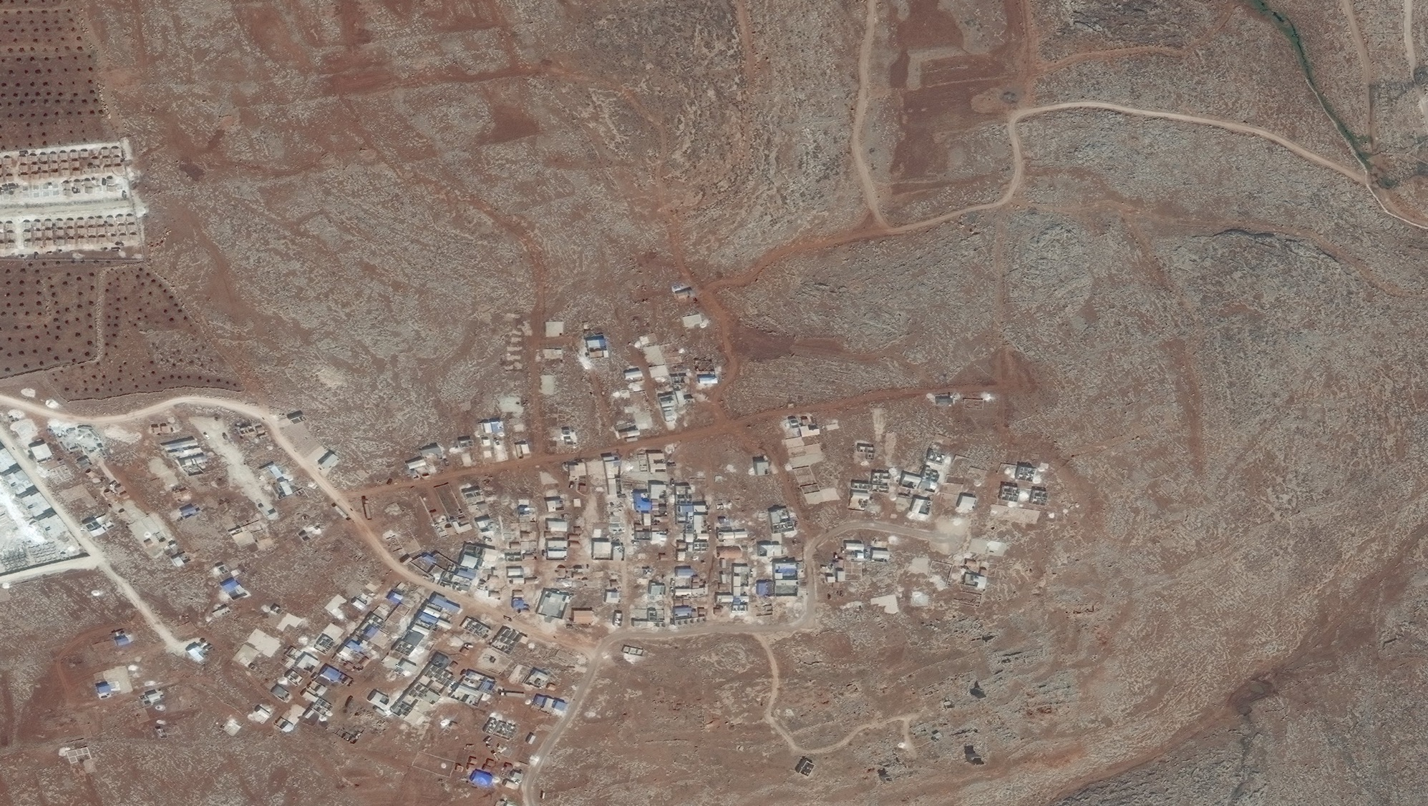
Fig 7a. Displacement camp B (detail), Idlib Governorate | 27 September 2017
Notes:
Satellite imagery © 2020 DigitalGlobe
Fig 7.a. IDP Camp (detail), Idlib Governorate Satellite imagery acquired 27 September 2017

Slide 32
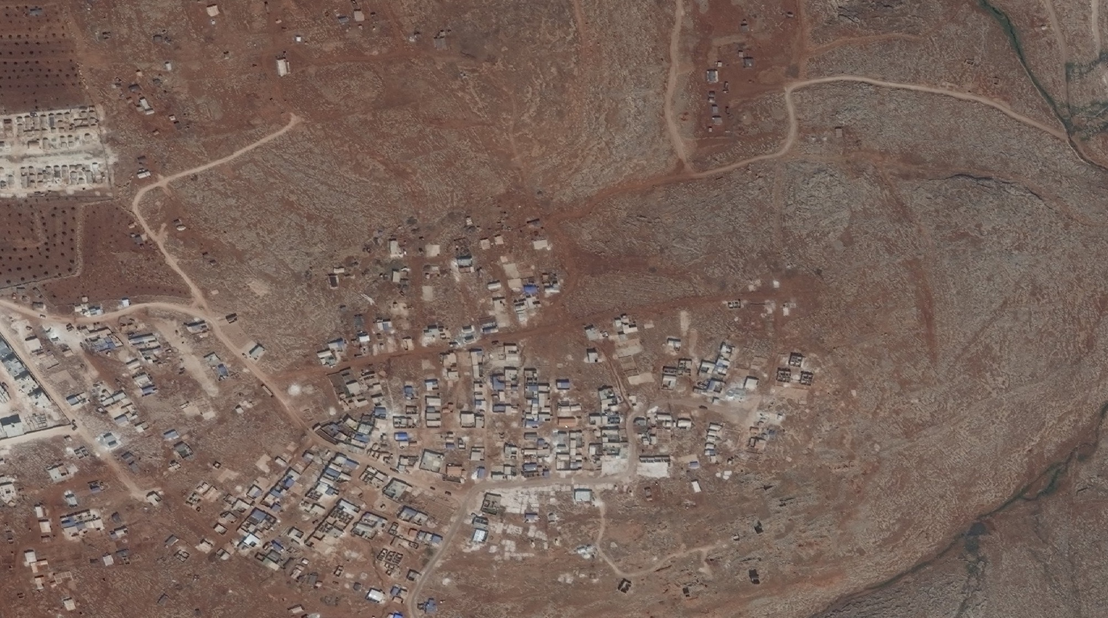
Fig 7c. IDP camp expansion of informal settlement, Idlib Governorate 27 September 2017
Notes:
Satellite imagery © 2020 DigitalGlobe
Fig 7.b. IDP camp (detail) and expansion of informal settlements, Idlib Governorate Satellite imagery acquired 26 September 2018

Slide 33
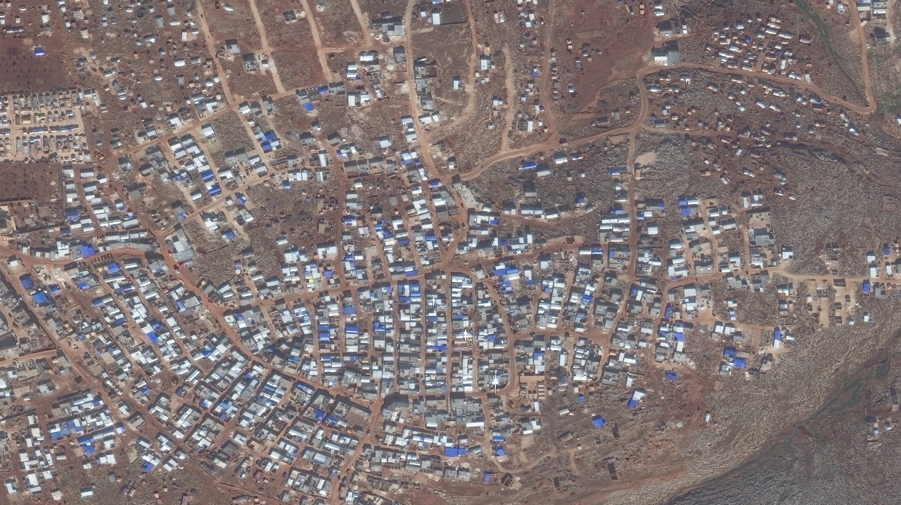
Fig 7c. Formalization, expansion and density increase, Idlib Governorate 27 September 2017
Notes:
Satellite imagery © 2020 DigitalGlobe
Fig 7.c. IDP camp formalization, expansion, and density increase, Idlib Governorate Satellite imagery acquired 2 December 2019

Slide 34
27 September 2017
26 September 2018
2 December 2019
Fig 7.d. IDP expansion, formalization and density increase 2017-2019, Idlib Governorate Meaningful but relatively modest growth between 2017 and 2018 is dwarfed by the increase in overall camp size, formalization and density by late 2019.
Satellite imagery ©2020 DigitalGlobe
Notes:
Satellite imagery © 2020 DigitalGlobe
Fig 7.d. IDP camp formalization, expansion, and density increase, Idlib Governorate Composite of Figs 7.a/b/c. Satellite imagery acquired 27 September 2017 (7.a), 26 September 2018 (7.b), 2 December 2019 (7.c).

Slide 35
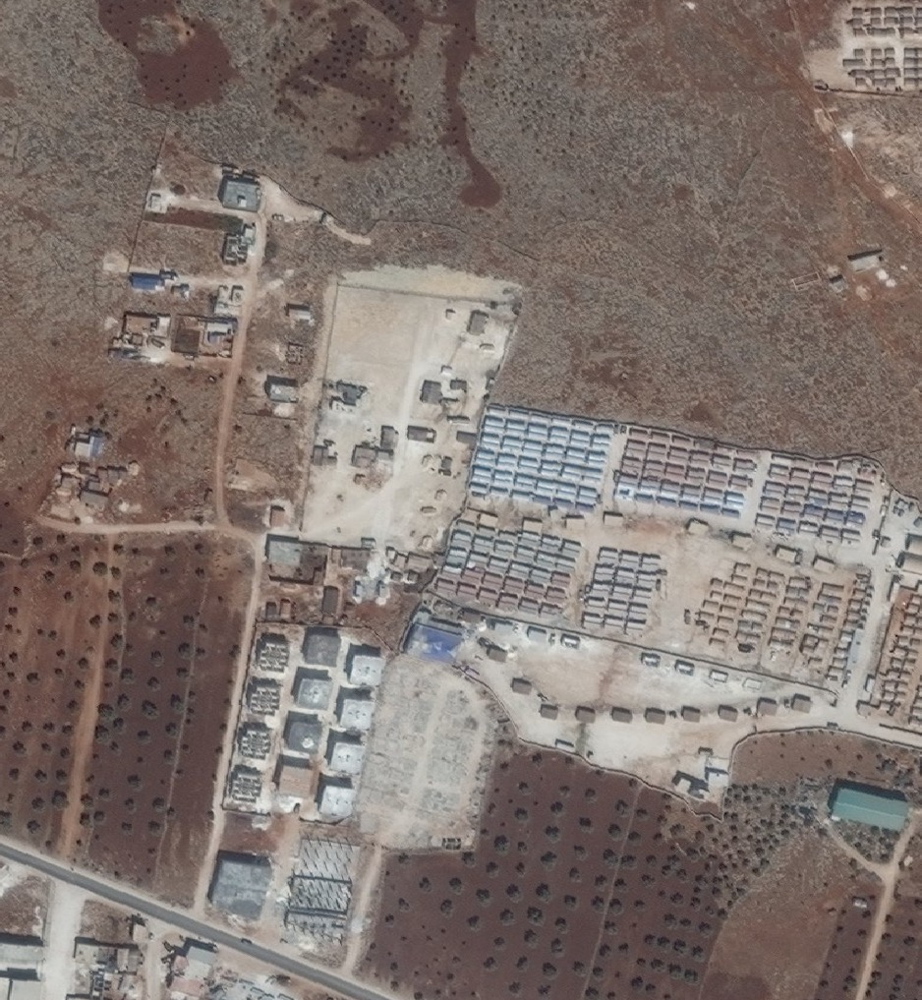
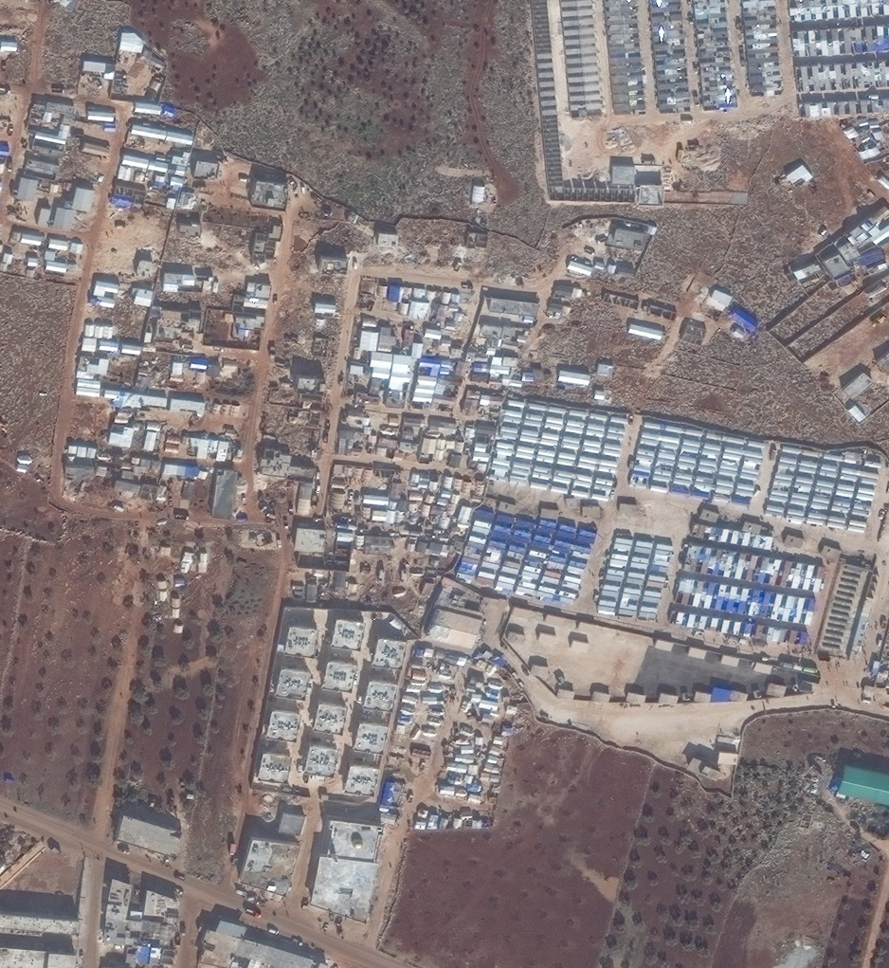
Fig 8. Camp expansion and formalization, Idlib Governorate
26 September 2018
2 December 2019
Notes:
Satellite imagery © 2020 DigitalGlobe
Fig 8. Detail: IDP camp expansion, formalized growth, Idlib Governorate

Slide 36
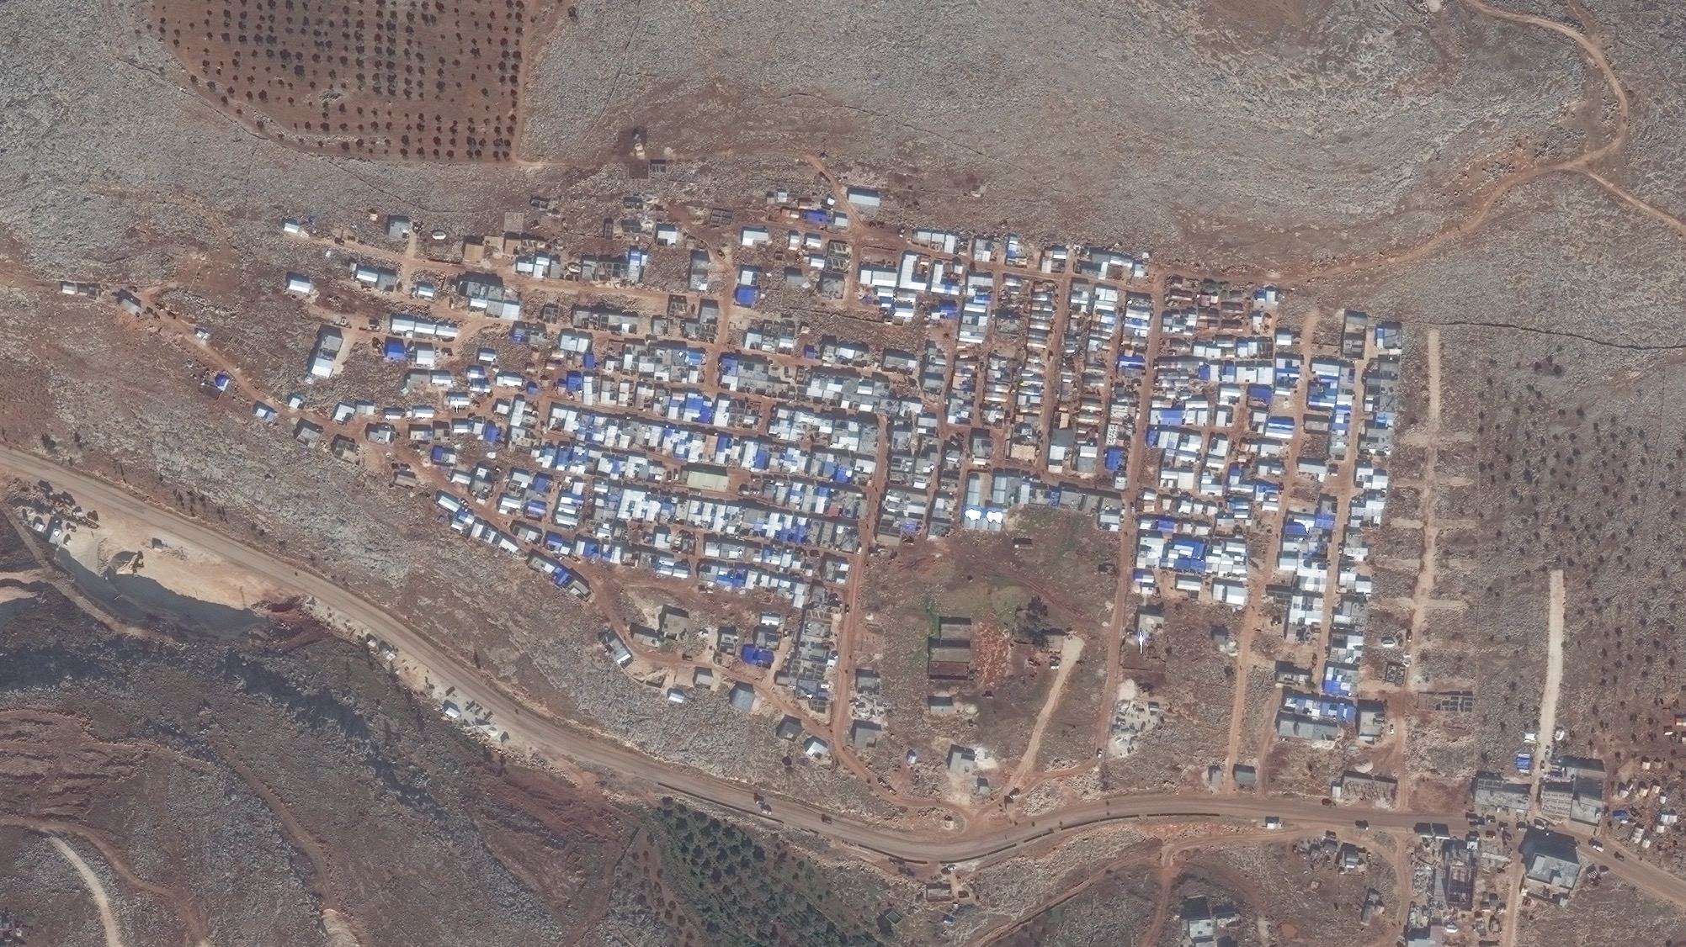
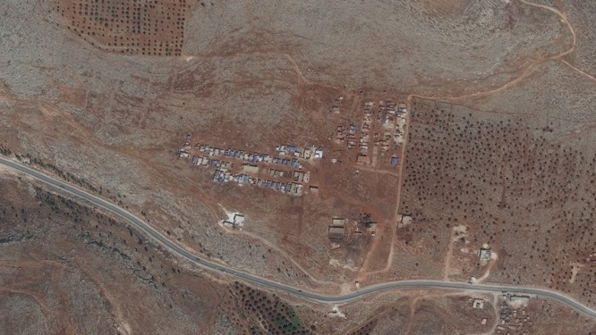
Fig 9. Camp growth and formalization, Idlib Governorate
2 December 2019
26 September 2018
Notes:
Satellite imagery © 2020 DigitalGlobe
Fig 9. IDP Camp growth and formalization, , Idlib Governorate
DATES

Slide 37
Structural Damage and Destruction
The imagery of structural damage in Southern Idlib captures the changes in the landscape between July 2018 and May 2019. Satellite imagery most clearly captures damage from above - particularly damage as a result of aerial bombardment. Ground offensives and shelling may produce structural damage not apparent from satellite imagery. This analysis may not, therefore, capture the entire extent of the damage in the analyzed area. The areas analyzed are referred to as Locations C and D.

Slide 38
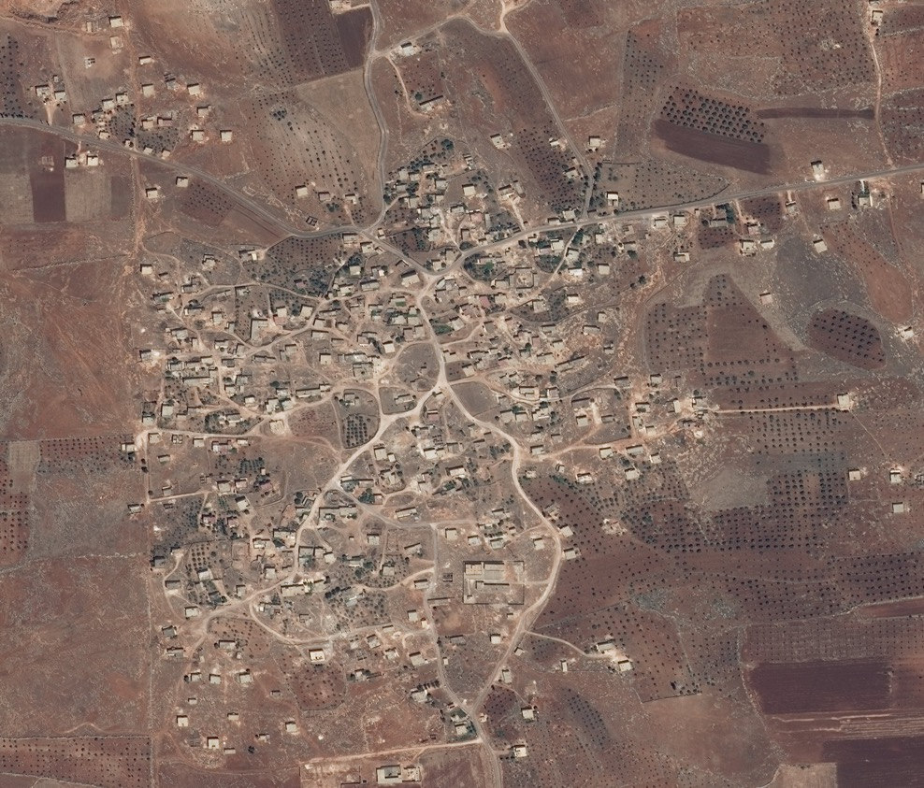
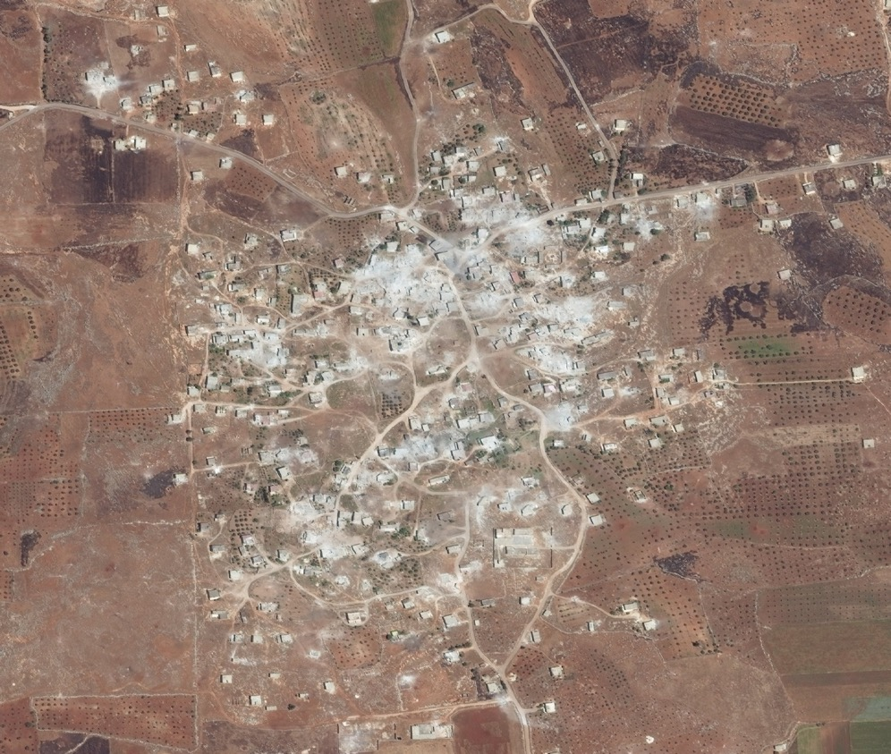
20 July 2018
26 May 2019
Notes:
Satellite imagery © 2020 DigitalGlobe
Fig 10.a.b. Structural damage, destruction and evidence of aerial bombardment at Location C, Idlib Governorate
Imagery acquired 20 July 2018
Imagery acquired 26 May 2019

Slide 39
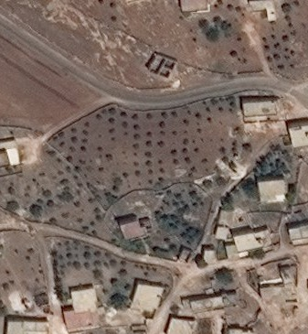
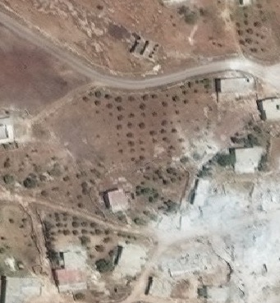
20 July 2018
26 May 2019
Notes:
Satellite imagery © 2020 DigitalGlobe
Fig 11.a.b. Structural damage and lack of apparent activity, Location C, Idlib Governorate
Prior to the destruction evident in May 2019, this area showed indications of structures under construction and agricultural activity. By 26 May 2019, the structure under construction in 2018 remains incomplete (without a roof); agricultural activity appears diminished despite no indication of new settlement activity.
Imagery acquired 20 July 2018
Imagery acquired 26 May 2019

Slide 40
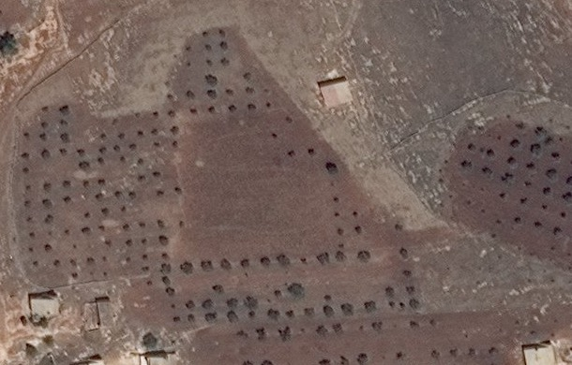
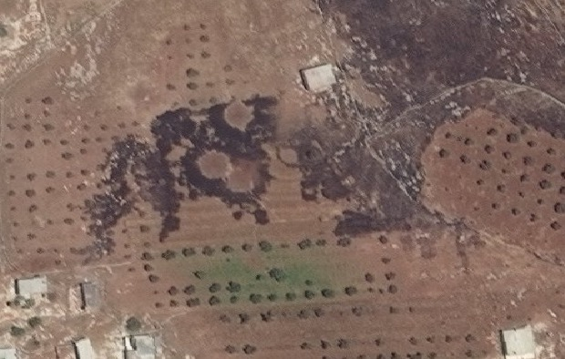
20 July 2018
26 May 2019
Fig 3.e. Cratering consistent with aerial bombardment, Idlib Governorate In imagery acquired 26 May 2019, cratering consistent with aerial bombardment appears at this site. Indications of scorched earth appear consistent with secondary fire caused by aerial bombardment, causing damage to surrounding crops.
Satellite imagery ©2020 DigitalGlobe
Notes:
Satellite imagery © 2020 DigitalGlobe
Fig 12.a.b. Cratering consistent with aerial bombardment, Location C, Idlib Governorate
Imagery acquired 20 July 2018
Imagery acquired 26 May 2019

Slide 41
Apparent Aerial Bombardment
Approximately 30% of the structures at Location C and D appear significantly damaged or obliterated, while the ground surrounding the structures remains largely intact. Ground reports suggest that the settlements in the analyzed region are no longer populated. While the satellite imagery indicates that a third of the settlements are destroyed, the imagery cannot verify the presence or absence of people. In the immediate surroundings of the structures in Locations C and D, there is visible evidence consistent with cratering as a result of mortar shelling and aerial bombardment. In May 2019, an active smoke plume as a result of fire is still visible at Location D. There appear to be track marks across the fields as well, though the timing of the tracks and craters may be unrelated.

Slide 42
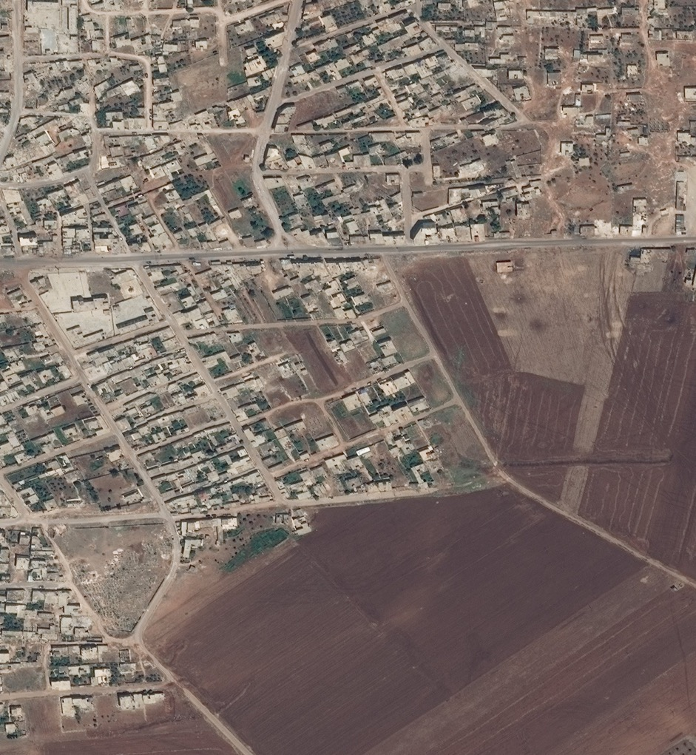
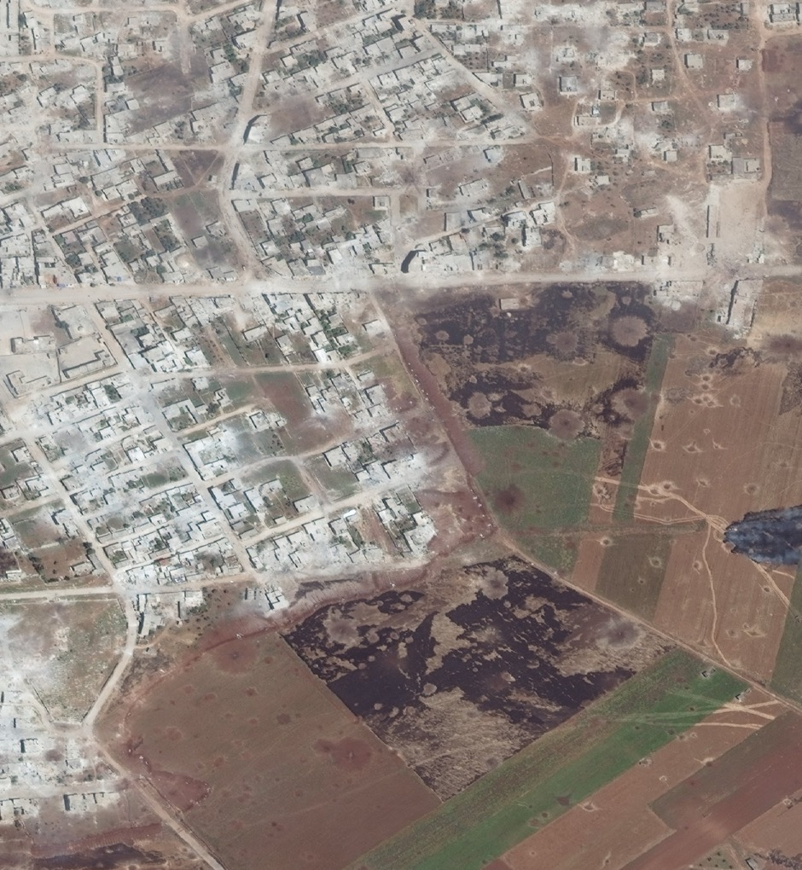
20 July 2018
26 May 2019
Notes:
Satellite imagery © 2020 DigitalGlobe
Fig 13.a.b. Apparent aerial bombardment at Location D, Idlib Governorate
Imagery acquired 20 July 2018
Imagery acquired 26 May 2019

Slide 43
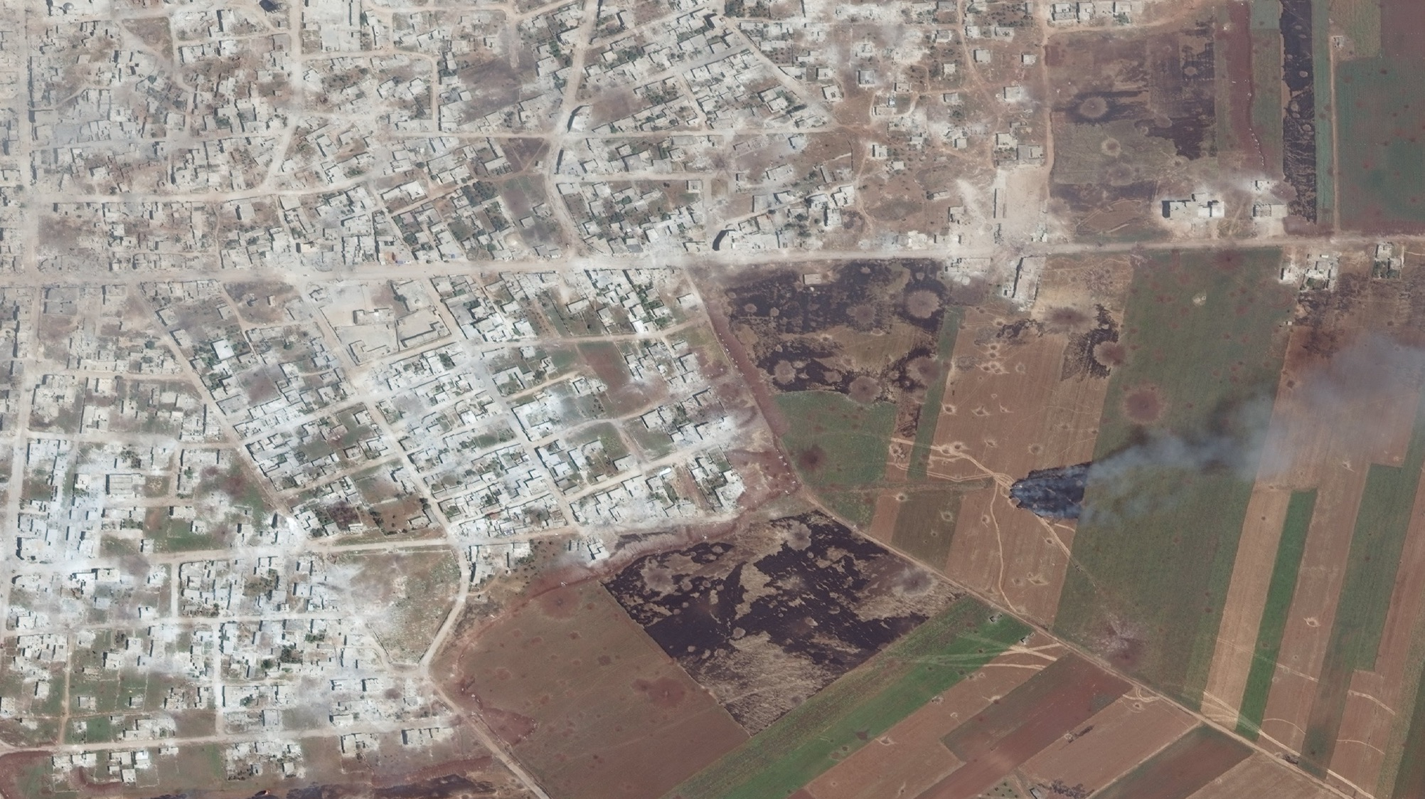
Fig 14.a. Apparent aerial bombardment, Idlib Governorate
Large craters consistent with aerial bombardment appear in the fields beyond the town; scorched earth due to secondary fires caused by bombardment is apparent, as a smoke plume rises from a still-burning plot of land. Smaller craters may be due to other, smaller forms of bombardment (e.g. mortars). Extensive damage to structures throughout the town is evident and consistent with aerial bombardment. It is important to note that not all structural damage may be evident via satellite imagery, as damage from shelling may render buildings unusable but still partially standing.
Notes:
Satellite imagery © 2020 DigitalGlobe
Fig 14.a. Apparent aerial bombardment, Idlib Governorate
Large craters consistent with aerial bombardment appear in the fields beyond the town; scorched earth due to secondary fires caused by bombardment is apparent, as a smoke plume rises from a still-burning plot of land. Smaller craters may be due to other, smaller forms of bombardment (e.g. mortars). Extensive damage to structures throughout the town is evident and consistent with aerial bombardment. It is important to note that not all structural damage may be evident via satellite imagery, as damage from shelling may render buildings unusable but still partially standing.
Imagery acquired 26 May 2019

Slide 44
Acknowledgments
The Signal Program at Harvard Humanitarian Initiative thanks the teams at Save the Children and World Vision, particularly Joelle Bassoul and Caroline Anning, for their leadership, expertise and the insight that led to this report.
This report was produced independently by the Signal Program on Human Security and Technology at Harvard Humanitarian Initiative. It is released under a Creative Commons Attribution-NonCommercial-ShareAlike 4.0 International license.
Media inquiries | chowarth@hsph.Harvard.edu, +1 (617) 384-5640

